Slide 1

Natural Buffers –
Are They a Tempest in a Teapot or a Storm in a Glass of Water
Buffers
Property Owners
HOW LOADED LABELS On PROPERTY taking BECOME A FAIT ACCOMPLI (Venus Flytrap)
Wednesday, November 13, 2013
1:47 PM
“Some people will never learn anything….because they understand everything too soon.”
Alexander Pope

Slide 2
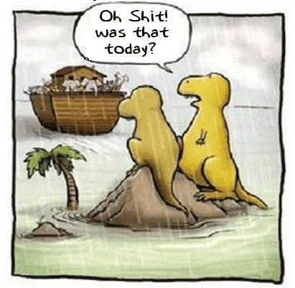
Definitions
“Having failed to distinguish thoughts from things, we then fail to distinguish words from thoughts. We think that if we can label a thing we have understood it.”
Maha Sthavira Sangarakshita
Legend of Abbreviations:
OSS = Onsite Septic System
GMA = Growth Management Act(s)
SMA = Shoreline Management Act
SMP = Shoreline Management Plan(s)
Buffer
“ n Brit informal a stupid or bumbling man (esp. in the phrase old buffer) [perhaps from Middle English buffer stammerer”
http://www.thefreedictionary.com/buffer
Buffer-zone
"Term used in zoning and land use law to describe area separating two different types of zones or classes of areas to make each blend more easily with each other; e.g. strip of land between industrial and residential areas.“
Black's Law Dictionary 1979 Fifth Edition
This term is not in the 1910 2nd Edition
Zoning
"The division of a city by legislative regulation into districts and the prescription and application in each district of regulations having to do with structural and architectural designs of buildings and of regulations prescribing use to which buildings within designated districts may be put." See also Buffer-zone, Comprehensive zoning plan; conforming use; land use planning; Master plan; official map; Planned unit development; Special exception; Special use permit; Spot zoning; Variance, Aesthetic zoning, Cluster zoning, Conditional zoning; Density zoning, Euclidean zoning; Exclusionary zoning, Floating zone.“
Black's Law Dictionary 1979 Fifth Edition
This term in not in the 1910 2nd Edition
Hypothesis – (science) an idea or explanation for something that is based on known facts but has not yet been proven.
Theory - Something suggested as a reasonable explanation for facts, a condition, or an event, especially a systematic or scientific explanation.
Axiom – a statement or principle that is generally accepted to be true
Postulate – to suggest or accept that a theory or idea is true as a starting point for reasoning or discussion.
Source: Cambridge Dictionaries Online
Model - A model is also a representation of something in words or numbers that can be used to tell what is likely to happen if particular facts are considered as true:

Slide 3
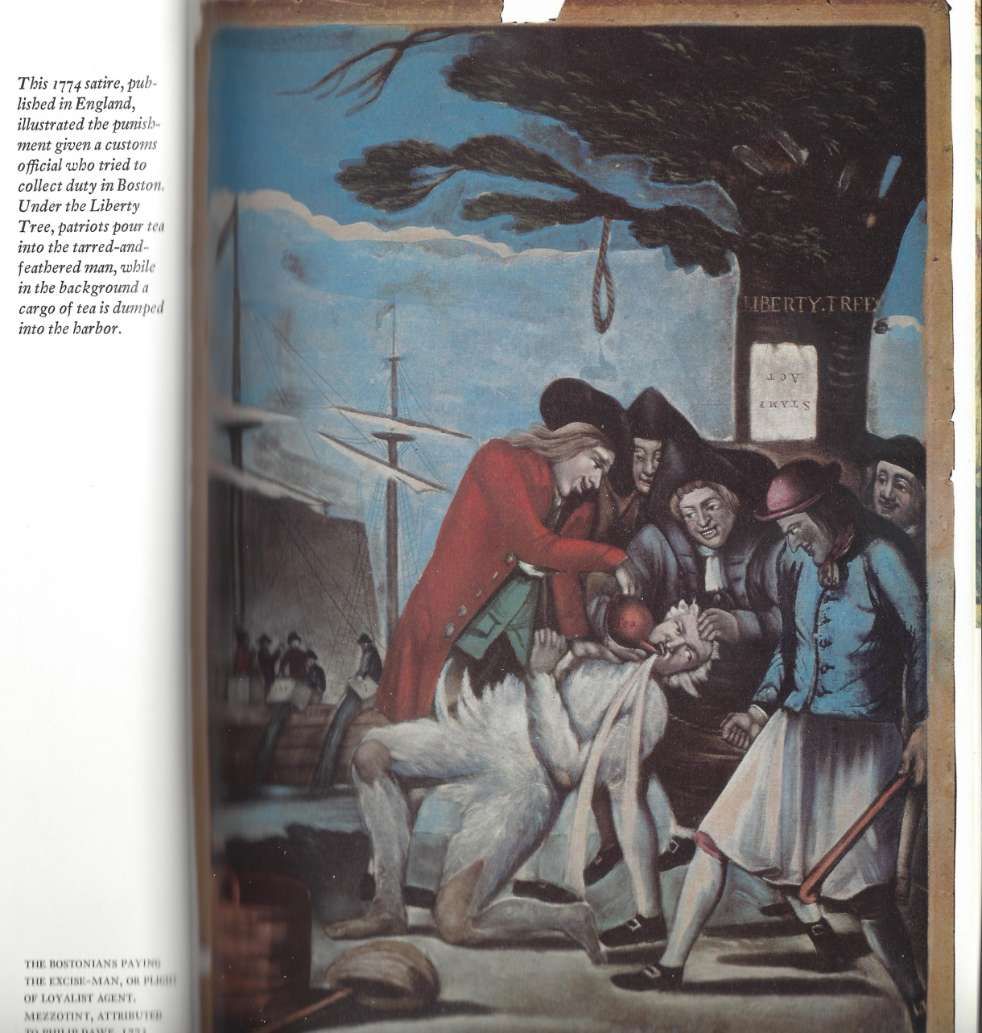
Definitions (continued)
“Your reality is a product of your belief system”
Mahatma I & II Brian Grattan
“Truth.
There are three conceptions as to what constitutes “truth”: agreement of thought and reality; eventual verifications; and consistency of thought with itself. For “Fact” and “truth” distinguished, see Fact.
Fact.
A thing done; an action performed or an incident transpiring; an event or circumstance; an actual occurrence; an actual happening in time space or an event mental or physical; that which has taken place, …. A fact is either a state of things, that is, an existence, or a motion, that is, an event, . The quality of being actual; actual existence or occurrence.
  Evidence. A circumstance, event or occurrence as it actually takes or took place…
  Fact and law distinguished. “Fact” is very frequently used in opposition or contrast to “law”. Thus, questions of fact are for the jury; questions of law for the court. Fraud in fact consists in an actual intention to defraud, carried in effect; while fraud imputed by law arises from the man’s conduct in its necessary relations and consequences.”
  Source of above definitions: “Black’s Law Dictionary, Fifth Edition”

Slide 4
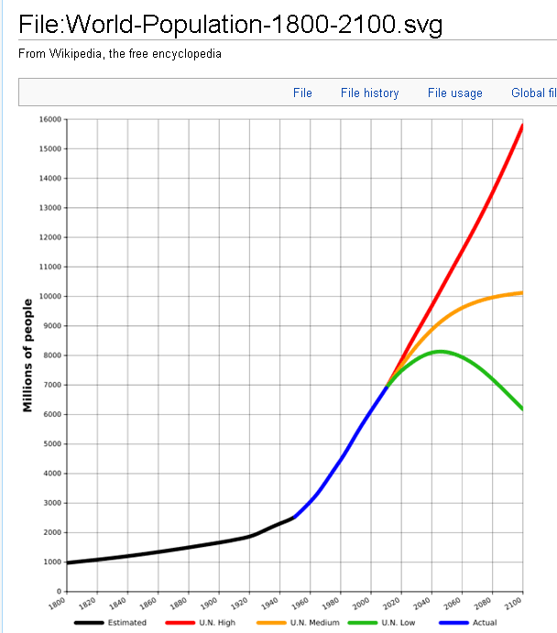
Definitions (continued)
Malthusian –
“1. of or pertaining to the theories of T. R. Malthus, which state that population tends to increase faster than the means of subsistence, resulting in an inadequate supply of food and necessary goods, unless war, famine or disease reduce the population or the increase of populations is slowed. “
The Random House Dictionary of the English Language - College Edition
The Malthusian Catastrophe
Another False Flag using fear to gain control of your resources, e.g. buffers
Bill of Attainder {Buffers are a Bill of Attainder}
Definition: A legislative act that singles out an individual or group for punishment without a trial.
The Constitution of the United States, Article I, Section 9, paragraph 3 provides that: "No Bill of Attainder or ex post facto Law will be passed."
"The Bill of Attainder Clause was intended not as a narrow, technical (and therefore soon to be outmoded) prohibition, but rather as an implementation of the separation of powers, a general safeguard against legislative exercise of the judicial function or more simply - trial by legislature." U.S. v. Brown, 381 U.S. 437, 440 (1965).
"These clauses of the Constitution are not of the broad, general nature of the Due Process Clause, but refer to rather precise legal terms which had a meaning under English law at the time the Constitution was adopted. A bill of attainder was a legislative act that singled out one or more persons and imposed punishment on them, without benefit of trial. Such actions were regarded as odious by the framers of the Constitution because it was the traditional role of a court, judging an individual case, to impose punishment." William H. Rehnquist, The Supreme Court, page 166.
"Bills of attainder, ex post facto laws, and laws impairing the obligations of contracts, are contrary to the first principles of the social compact, and to every principle of sound legislation. ... The sober people of America are weary of the fluctuating policy which has directed the public councils. They have seen with regret and indignation that sudden changes and legislative interferences, in cases affecting personal rights, become jobs in the hands of enterprising and influential speculators, and snares to the more-industrious and less-informed part of the community." James Madison, Federalist Number 44, 1788.
Supreme Court cases construing the Bill of Attainder clause include:
Ex Parte Garland, 4 Wallace 333 (1866).
Cummings v. Missouri, 4 Wallace 277 (1866).
U.S. v. Brown, 381 U.S. 437 (1965).
Nixon v. Administrator of General Services, 433 U.S.425 (1977).
Selective Service Administration v. Minnesota PIRG, 468 U.S. 841 (1984).
See also, SBC v. FCC.

Slide 5
Definitions (continued)
Agenda 21 Terminology Translation by Robb Cadwell
Vision: My ideas and people who think as I do.
Sustainable: If this type of thing went on for a long time I wouldn’t agitate against it.
Inter-disciplinary: If I don’t agree with the science I’ll get someone on board who will, preferably a sociologist from Berkley who is good at public relations.
Common Good: I know what’s best for you.
Best Management Practices: Don’t blame me because things went wrong, I covered my butt with a long paper trail.
Restoration: I want things to look just like they do on modern Hollywood westerns.
Public/Private partnerships: My friends are going to get a piece of this thing and if you go along you can too.
Watershed: Catch and release fly fishermen.
Preserve: Preserved for bird watchers only.
Endangered species: Not a vegetable or mineral, amended to include any plant except those sold in Whole Foods.
Historic Preservation: I want cute looking houses to drive past and I’m going to make you keep your house cute by law.
Benefit of all: I know what’s best for you in the long run even if you don’t.
Consensus: We might pretend to listen to you, but at the end of the day we’ll simply outlast you at the meeting and vote later after you’ve gone home.
Traffic Calming: We’re going to put in traffic circles so you and your doggone horse trailers don’t drive in my neighborhood. Can also mean raised beds with annuals.
Landscape: Used with words like “wide” or “level” meaning someone wants to impose something over hundreds of square miles. Something pretty enough to be photographed. A telltale that the user has origins in the burgs of one coast or another where landscaping is what you pay people much poorer than yourself to do to your yard.
Facilitator: Someone to calm the crazies without committing to anything.
Affordable Housing: We don’t want trailers so we’ll build some condos school teachers can afford but please, no poor people.
Smart Growth: Sprawl with bike paths.
Livable Communities: Cul de sacs with bike paths all the way to Starbucks.
Stakeholder: blood sucking vampire that can only be put to rest with a wooden stake through the heart. If someone calls you a stakeholder consider yourself officially “undead”.
Smart Growth: My ideas are smart, yours are dumb.
http://www.hcn.org/issues/44.2/fearful-of-Agenda-21-an-alleged-united-nations-plot-activists-derail-land-use-planning

Slide 6
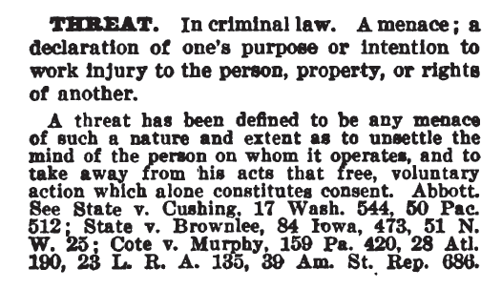
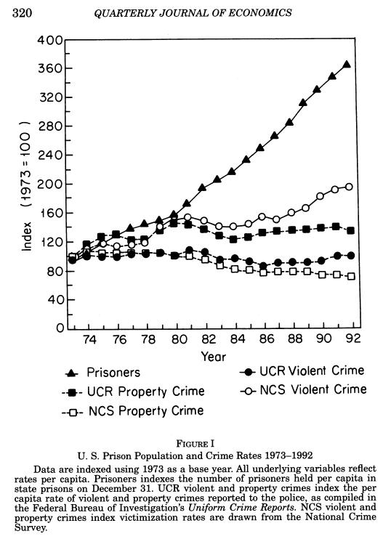
Abstract - one paragraph
“To one who has had the experience there is no need to explain it. To one who has not, there is no way to explain it. What to do but to exclaim!”
Reikichi Kita and Kiichi Nagaya
One Paragraph –
Buffers are a place card holder of artificial legal fiction threats to establish a false determination which is largely hypnotic. This false condition is overlaid by benefiting government and NGO groups to vilify property and business owners and their ownership rights thereby better centralizing and transferring individual land allodial rights from rightful individual state Citizens into the hands of the global to local elite. The global to local special interests are using environmental loaded labeling to expand and take predatory control over private and public property under the guise of environmental protection. This is accomplished through a bundle of loaded labels including buffers, wetlands, critical areas, sensitive areas, shoreline and growth management, zoning, open space, smart growth, heritage areas, endangered species, “man caused” global warming, “alternative” energy, etc.
Black’s Law Dictionary – 1910 2nd Edition

Slide 7
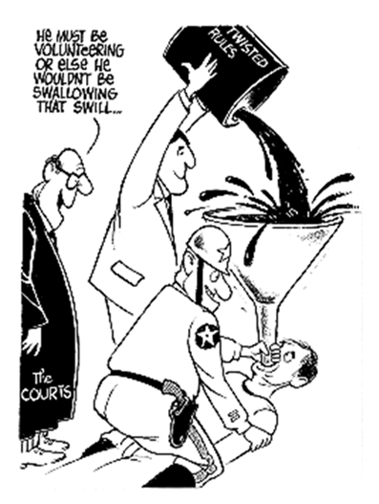
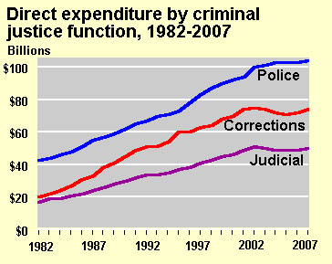
Abstract – bursting the buffer bubble
“Only the supremely wise and the abysmally ignorant do not change.”
Confucius
“Buffers” originated from United Nations Educational, Scientific and Cultural Organization (UNESCO) around 1970 as part of the World Heritage Biosphere Reserve movement.
Buffers are one label in a bundle of labels used to take private and public property against all odds. Other labels include Shoreline Management, Growth Management, Critical Areas, Sensitive Areas, Wetlands, Endangered Species, Man Caused Global Warming, Alternative Energy, ad nausea. All these takings are based largely on lies and one sided agenda “science” which does not tolerate challenges outside the box.
You will see herein credible findings debunking buffers as well as other green highly emotional labeling.
You will see how these false flag takings are staged to appear real as if there was no other alternatives or credible opposition.
You will see how easy it is to manipulate the data and studies creating these green extreme programs and how often environmental fraud happens.
You will ask yourself why this “research” was allowed to leave the laboratory let alone enter into our real life and real property destroying those rights.
You will see how this is a world wide taking , global to local.
You will see evidence these environmental takings under the guise of social and environmental common good are largely failures.
You will see the skullduggery behind the UN and municipal council doors.
You will see the hypocritical double standards of shutting down a home for the want of a repair on a septic system while 5 minutes away $5 million of public debt, usury and regulatory swill is created widening the mouth of a small creek plus million dollar fish culvert roundabouts.
You will see millions of people culled into ant and bee like eusocial colonies to suit these global to local agendas rooting to international soil.
You will see in detail the clear failure of the basic objectives of the GMA (Growth Management Act).
You will see the green buffer buffoon planners drinking and forcing you to drink the global to local swill.
You will see massive eusocial rural to local culling debased on speculation not true and honest independent peer review science approved by all impacted property and business owners.
No rightful American state Citizen can be made prisoner to green loaded labels .
Muni Buffer Swill
Property Owner

Slide 8
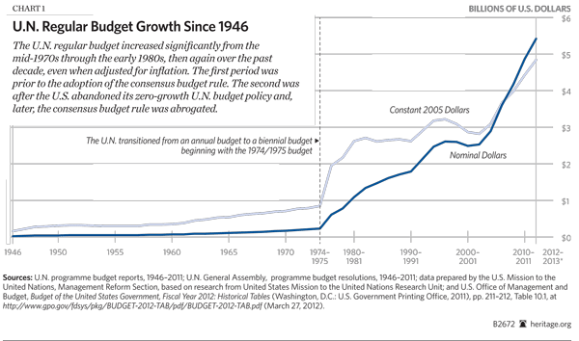

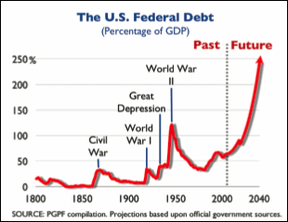
Buffers – global fait accompli
American private and public land grabs by united nations educational, scientific and cultural organization (unesco)
“Our eyes were originally right, but went wrong because of teachers.”
Zen Proverb
“The concept of a buffer zone was first included in the Operational Guidelines for the implementation of the World Heritage Convention in 1977. In the most current version of the Operational Guidelines of 2005 the inclusion of a buffer zone into a nomination of a site to the World Heritage List is strongly recommended but not mandatory.”
“How did the biosphere reserve concept start?
    “The origin of Biosphere Reserves goes back to the "Biosphere Conference" organized by UNESCO in 1968. This was the 1st intergovernmental conference examining how to reconcile the conservation and use of natural resources, thereby foreshadowing the present-day notion of sustainable development. This Conference resulted in the launching of the UNESCO "Man and the Biosphere" (MAB) Programme in 1970. One of the original MAB projects consisted in establishing a coordinated World Network of sites representing the main ecosystems of the planet in which genetic resources would be protected, and where research on ecosystems as well as monitoring and training work could be carried out. These sites were named as "Biosphere Reserves", in reference to the MAB programme itself. “
    Source of above material - http://whc.unesco.org/en/events/473/
“What are the biosphere reserve zones?
      Biosphere reserves are organized into 3 interrelated zones:
        the core area
        the buffer zone
        the transition area “
    Source - http://www.unesco.org/pv_obj_cache/pv_obj_id_08FF760D7B48531828598628142D6FAA01590000/filename/brs.pdf

Slide 9
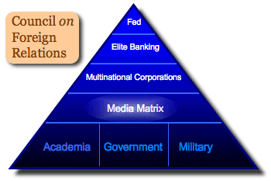
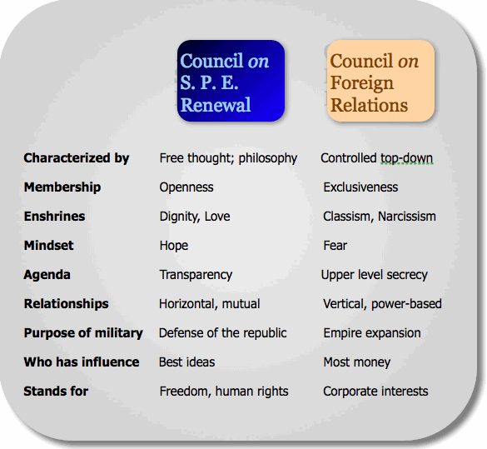
Buffers – how globalist infest local property
William Benton, Assistant U.S. Secretary of State, told a UNESCO meeting in 1946:
We are at the beginning of a long process of breaking down the walls of national sovereignty. UNESCO must be the pioneer.”
http://sovereignty.net/p/gov/rise/risetoc.htm
"Thus even though it is quite true that any radical eugenic policy will be for many years politically and psychologically impossible, it will be important for UNESCO to see that the eugenic problem is examined with the greatest care, and that the public mind is informed of the issues at stake so that much that now is unthinkable may at least become thinkable”
“UNESCO's primary function is set forth in its Charter: "Since wars begin in the minds of men, it is in the minds of men that the defenses of peace must be constructed.” UNESCO was created to construct a world-wide education program to prepare the world for global governance. UNESCO advisor, Bertrand Russell, writing for the UNESCO Journal, The Impact of Science on Society, said: "Every government that has been in control of education for a generation will be able to control its subjects securely without the need of armies or policemen ....”²⁰ The National Education Association was a major advocate for UNESCO. In a 1942 article in the NEA Journal, written by Joy Elmer Morgan, the NEA called for " ...certain world agencies of administration such as: a police force; a board of education ....”
"Public ownership is the only basis on which we can hope to protect the incalculable values of the forests for wood resources, for soil and water conservation, and for recreation.... Regardless of whether it might be desirable, it is impossible under our existing form of government to confiscate the private forests into public ownership. We cannot afford to delay their nationalization until the form of government changes.”³⁷
"Under the American concept of rights, the individual possesses God-given rights which the state must protect. However, the UN embraces a collectivist worldview in which 'rights' are highly conditional concessions made by an all-powerful government.”⁴⁵
"World development is not merely an economic process, [it] involves a profound transformation of the entire economic and social structure... not only the idea of economic betterment, but also of greater human dignity, security, justice and equity.... The Commission realizes that mankind has to develop a concept of a 'single community' to develop a global order."
Source: “The Rise of Global Government” by Henry Lamb

Slide 10


The connection of unesco to global to local power – Part 1 of 2
The Texas legal case of Kelo Vs. New London in 2005 established that private property can be taken by eminent domain for it’s “highest and best use.” Human life can also be factored in terms of “highest and best use.”
Joan Veon
“Israel has twice witnessed its {UNESCO} management of the Old City of Jerusalem and its Walls thwarted by the U.N.
“Algier Hiss, a convicted communist, was the first U.N. Secretary General. He was convicted and sentenced for lying to Congress.
The U.S. Constitution says that our rights come from God, these are inalienable rights and can’t be taken away. We have a Republic form of government, property rights, individual liberty, and supposedly limited government.
By contrast, the U.N. Charter, based on the Russian constitution, states that our rights come from government, they are a limited number of these rights, they can be taken away for behavior or speech. This would institute a feudalistic form of government. “For the common good,” it eliminates the rights of the individual.
This is a mechanism for bringing about communism with the U.N. as head of state. Are we now seeing communism becoming established in America through initiation of rules regulations, and control.
The U.N. now has a governing body (the general assembly), a currency (special drawing rights), a treasury system (the IMF/WB), as well as a court and legal system (the World Court and International Criminal Court),
A brief history of important U.N. meetings:
1970’s- A series of conferences occurred but meetings were blacked out
1976- Habitat I was held in Vancouver, BC
1992- Agenda 21 emerged out of the Rio Earth Summit
1994 – There was a meeting on population reduction (Habitat I)
1995- Copenhagen meeting- social summit- to empower the UN
1995- Women’s conference in Beijing, Conference
1996- Meeting in Instanbul, Habitat II, talked ..Smart Growth
2000 Millennium summit in September was held in which kings, princes, presidents, and prime ministers agreed to the 1st complete over-hauling and empowerment of the U.N. since 1945. They agreed to strengthen international law and add an international house of representatives. So in the future we might elect our own UN Representatives
6/04 - The Sec. General, through global taxation, would control a rapid deployment force. They also agree that the U.N. should have trusteeship over the “global commons,” including space, oceans and the atmosphere. “
Source: Summary of Joan Veon DVD: The World Government Connection: (made in March, 2006)

Slide 11
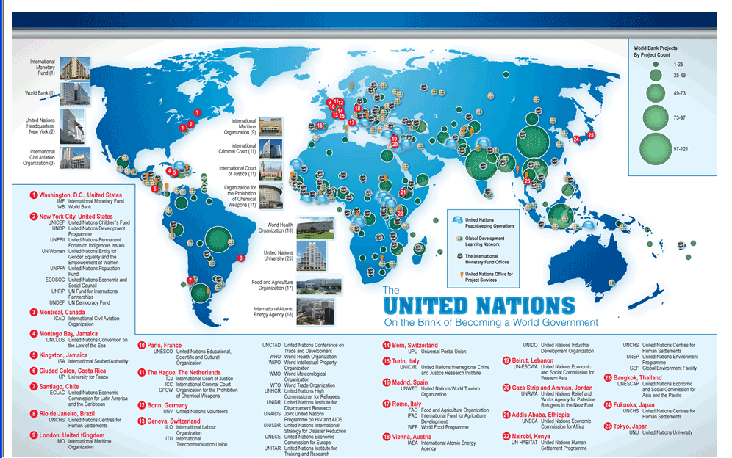
The connection of unesco to global power – Part 2 of 2
“UNESCO fertilizes the psychological soil that other myths are build upon.”
Anonymous
Click on map to view full report
“The story is similar at UNESCO, which, besides boasting a palatial edifice in Paris, called the World Heritage Center, has field offices, cluster offices, national offices, regional bureaus, and liaison offices in more than 50 countries throughout the world. This same pattern is repeated for many other UN agencies.
UNESCO has insinuated itself into American schools and families through “partnerships” with our federal and state Education Departments that include curriculum design and invasive, psychologically manipulative “emotional wellness” evaluations. “
UNESCO has insinuated itself into American schools and families through “partnerships” with our federal and state Education Departments that include curriculum design and invasive, psychologically manipulative “emotional wellness” evaluations. “
Source: “United Nations On the Brink of Becoming a World Government by William F. Jasper.
Reagan got America out of UNESCO in 1984 and Bush put us back in at an enormous expense in 2003. Britain also got out in 1985 – 1997.
  “THE UNITED NATIONS EDUCATIONAL, SCIENTICIC, & CULTURAL ORGANIZATION: A UNITED NATIONS AGENCY WHICH REGULARLY ACTS AGAINST AMERICA'S NATIONAL INTERESTS & BASIC CULTURAL VALUES & WHICH FUNCTIONS AS A MOUTHPIECE FOR GLOBALISM & BLATANT ANTI-AMERICANISM & FOR WORLD GOVERNMENT, GLOBAL STATISM & SOCIALISM, POLITICAL ENVIRONMENTALISM, INTERNATIONAL POPULATION CONTROL THROUGH WHOLESALE ABORTIONS, IMPOSITION OF A "POLITICALLY CORRECT" UN CURRICULUM ON AMERICA'S DOMESTIC EDUCATIONAL SYSTEM, UN CONTROL OF FEDERAL LAND IN THE U.S.A. THROUGH SOCALLED "WORLD HERITAGE SITES," & OTHER RADICAL CAUSES PUSHED BY THE UN BUREAUCRACY & ITS POLITICAL ALLIES & SUPPORTERS IN THE DIFFERENT NATIONAL GOVERNMENTS, IN LEFTIST POLITICAL PARTIES & FACTIONS, & IN THE LIBERAL INTERNATIONALIST, LEFTIST SEGMENTS OF THE WESTERN MEDIA -- WHY SHOULD THE AMERICAN TAXPAYERS BE REQUIRED TO FUND TWENTY-FIVE PERCENT OF UNESCO'S BUDGET & PAY DEARLY FOR THE PRIVILEGE OF U.S. MEMBERSHIP IN AN ANTI-AMERICAN ORGANIZATION? “
  “Why do We Fund UNESCO? Dr. Ron Paul

Slide 12
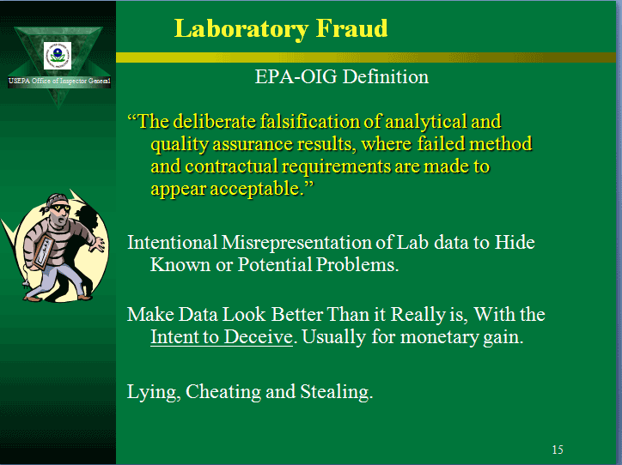
Dry labbing Part 1 of 2 –
One facet of junk science
Not till your thoughts cease their branching here and there, not till you abandon all thoughts of seeking for something, not till your mind is motionless as wood or stone, will you be on the right road to the Gate."
Huang-Po
Here is a short list of some of the creative ways this is done.
Selective data mining to suit the agendas of the study organizers (cherry picking).
Assume the "problem(s)" conjured up are real without fully testing the hypothesis that the so called “problem” is truly the problem.
If testing of the "problem(s )” is done, they do not test their assumptions outside of their own niche groups due to limited funding and the desire to keep outcome based agendas from being challenged.
Complex statistical analysis often expand into modeling to force the “simulation” into the expected agenda or at least the desire is there to satisfy the agenda.
Man made models (formulas) are conjured up to replace or enhance real data because it is cheaper and more easily manipulated into desired agendas.
Honest passionate professional expert (s) often come up against their own belief system, i.e. do I believe this data or my common sense or neither one.
Selective choosing the variables (data) to be studied through personal or professional bias, i.e. allowing highly intercorrelated or falsely correlated data into the selection process and covering it up.
False labels and cherry picking the data by selective highly biased passionate researchers creates a sense of public legitimacy to an unwary public. The labeling and mere acts of the study are amplified out of context by media, NGO’s and political pronouncements. The act of the study makes the hypothesis seem true.
Contrary theories, hypothesis, alternative problems and solutions with credible data is suppressed and ridiculed.
The public involvement strategy is further manipulated by government experts leading the "public opinion" into a common cause green consensus.
Assumptions are constantly changed to suit the agenda of those initiating the studies to better assure the predetermined conclusions are met for grants and careers.
The organizational hierarchy of those involved in orchestrating social and environmental centralized plans are connected to the funding sources, i.e. grants, taxes, usury and regulations.
Dry labbing is an expression indicating the study and the data have been cooked. It is near impossible to avoid dry labbing research because the intentions of the researchers and field agents gathering the data heavily influence the study right and wrong.
This is another reason why political agendas to label and control everything, e.g. shorelines (SMA), growth (GMA), buffers, so called “sensitive (SAO) and critical area (CAO) are loaded designations debased from the get go by the mere act of labeling, i.e. manipulating and marketing the green swill to the public.
Lab Fraud - DOE Consolidated Audit Program

Slide 13
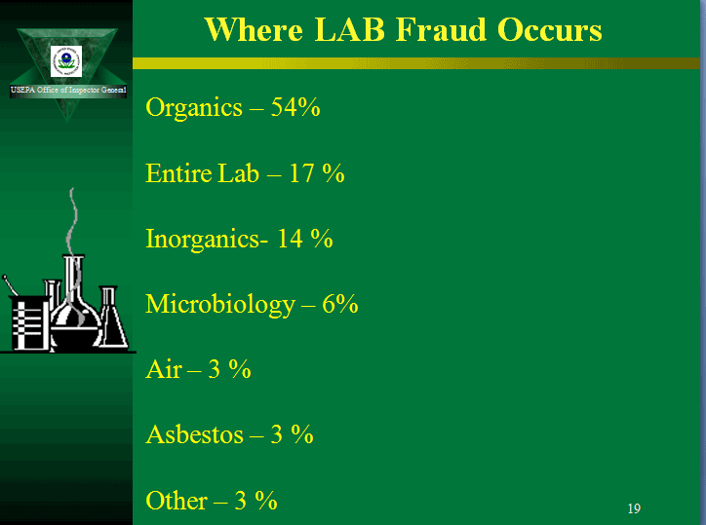
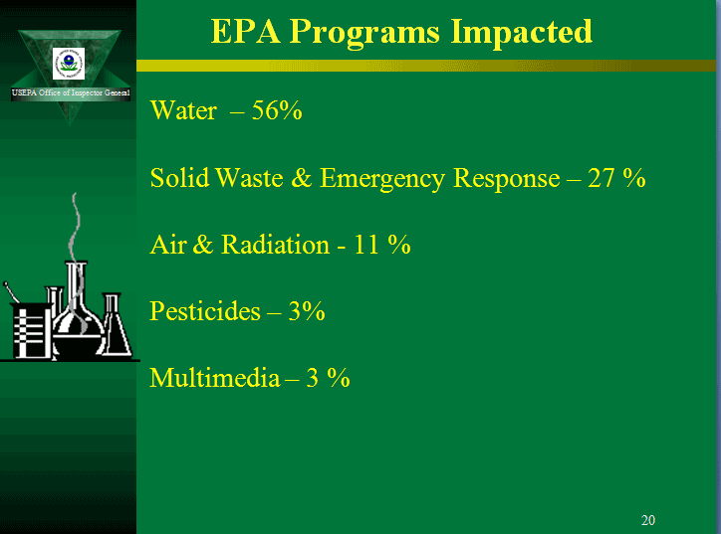
Dry labbing – part 2 of 2
“The more I read, the more I meditate: and the more I acquire, the more certain I am that I know nothing.”
Voltaire
Dry labbing it, baby
In the 1980s, it was determined that many CLP (EPA Contract Lab Program) laboratories were committing fraud in order to be cost competitive and meet time demands of the CLP program. At one time in the 1980s, more than 25% of the laboratories in the CLP program were under investigation.
“environmental dry labbing” hits
4. (c)Microbiologist – Fred is an analyst who works 7:30 AM to 4:00 PM analyzing drinking water samples for total coliform using IDEXX Colilert. Once each day he….. Read this report re. What’s unethical and/or improper with this scenario?
4. (d) Chemistry Scenario 1- Joe is a wastewater operator. He never sees changes in the refrigerator’s temperature. It is always 4°C. He reads a thermometer that does not have a correction factor indicated…Read this report re. What’s unethical and/or improper with this scenario?
4. (d) Chemistry Scenario 2 - Molly analyzes drinking waters for UV-absorbing organics using SM 5910 B. She filters the sample through a Gelman type GN-6 plastic polymer
Chemist faces charges for "dry-labbing"
Lab Fraud - DOE Consolidated Audit Program

Slide 14


Silent spring – CLASSIC CASES OF DRY LABBING i.e. who is killing whom? - Part 1 of 3
“A little unlearning goes a long way.”
Richard Kehl
DDT - A Case Study in Scientific Fraud (MUST READ) by J. Gordon Edwards, Ph.D
100 Things You Should Know About DDT (MUST READ) by J. Gordon Edwards, Ph.D & Steven Milloy
Scientist Who Warned Against DDT Ban Dies (MUST READ)
The Truth about DDT and Silent Spring (MUST READ)
Silent Spring’s Shoddy Science - Reason_com
Silent Spring At 50 - Reflections On An Environmental Classic (PERC - Must Read)
Silent Spring's 50 Year History of Selective Data
The Grim 50th Anniversary of Silent Spring
Facts versus Fears
PERC Book Review

Slide 15
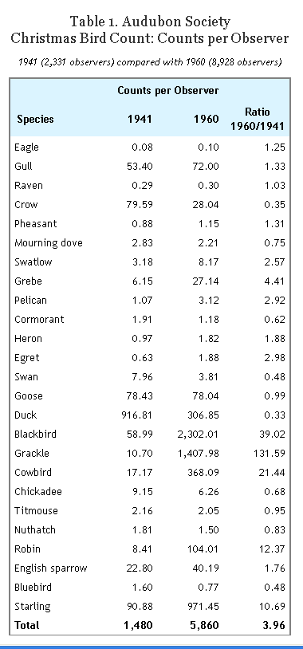
Silent spring –CLASSIC CASES OF DRY LABBING, i.e. who is killing whom ? - Part 2 of 3
“Unfortunately, however, the administrator of the EPA was William D. Ruckelshaus, (link to check out his career after this disaster) who reportedly did not attend a single hour of the investigative hearings, and according to his chief of staff, did not even read Judge Sweeney’s report, “The Rise, Fall, Rise, and Imminent Fall of DDT,” Instead, he apparently chose to ignore the science: overruling Sweeney, in 1972 Ruckelshaus banned the use of DDT in the United States except under conditions of medical emergencies.”
“The Truth about DDT and Silent Spring”
“After many years of carefully controlled feeding experiments, Dr. M. L. Scott and associates of the Department of Poultry Science at Cornell University “found no tremors, no mortality, no thinning of eggshells and no interference with reproduction caused by levels of DDT which were as high as those reported to be present in most of the wild birds where ‘catastrophic’ decreases in shell quality and reproduction have been claimed.” In fact, thinning eggshells can have many causes, including season of the year, nutrition (in particular insufficient calcium, phosphorus, vitamin D, and manganese), temperature rise, type of soil, and breeding conditions (e.g., sunlight and crowding).”
“Facts Versus Fears: DDT”, American Council on Science and Health
“And what of the charges leveled against DDT? A 1978 National Cancer Institute report concluded—after two years of testing on several different strains of cancer-prone mice and rats—that DDT was not carcinogenic. As for the DDT-caused eggshell thinning, it is unclear whether it did, in fact, occur and, if it did, whether the thinning was caused by DDT, by mercury, by PCBs, or by the effects of human encroachment. And as recently as 1998 researchers reported that thrush eggshells in Great Britain had been thinning at a steady rate 47 years before DDT hit the market; the researchers placed the blame on the early consequences of industrialization.”
“Facts Versus Fears: DDT”, American Council on Science and Health

Slide 16
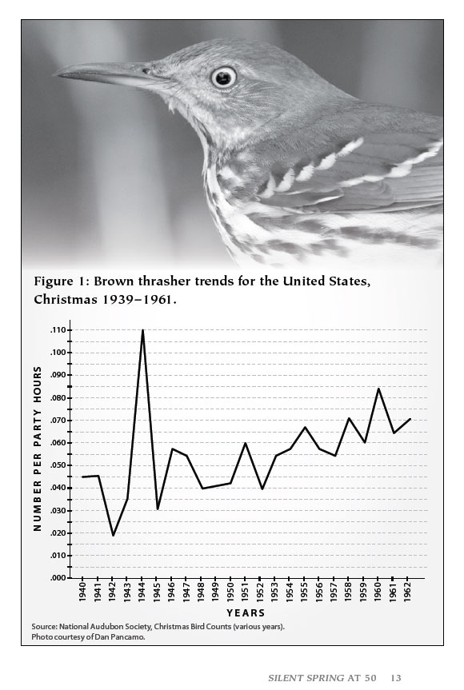

Silent spring –classic cases of dry labbing, i.e. who is killing whom ? - part 3 of 3
Photo credit to ALAMY article to left in “The Telegraph”
Cris Bouroncle
AFP,Getty Images
Killer cats: deadly pets murder nearly 4 billion birds a year The Telegraph
Hundreds of additional hits regarding this story
“ In addition, later research refuted the original studies that had pointed to DDT as a cause for egg shell thinning. After reassessing their findings using more modern methodology, Drs. Hickey and Anderson admitted that the egg extracts they had studied contained little or no DDT and said they were now pursuing PCBs, chemicals used as capacitor insulators, as the culprit.²⁰
When carefully reviewed, Dr. Bitman’s study revealed that the quail in the study were fed a diet with a calcium content of only 0.56 percent (a normal quail diet consists of 2.7 percent calcium). Calcium deficiency is a known cause of thin eggshells. After much criticism, Bitman repeated the test, this time with sufficient calcium levels. The birds produced eggs without thinned shells.” Facts Versus Fears: DDT, American Council on Science and Health

Slide 17
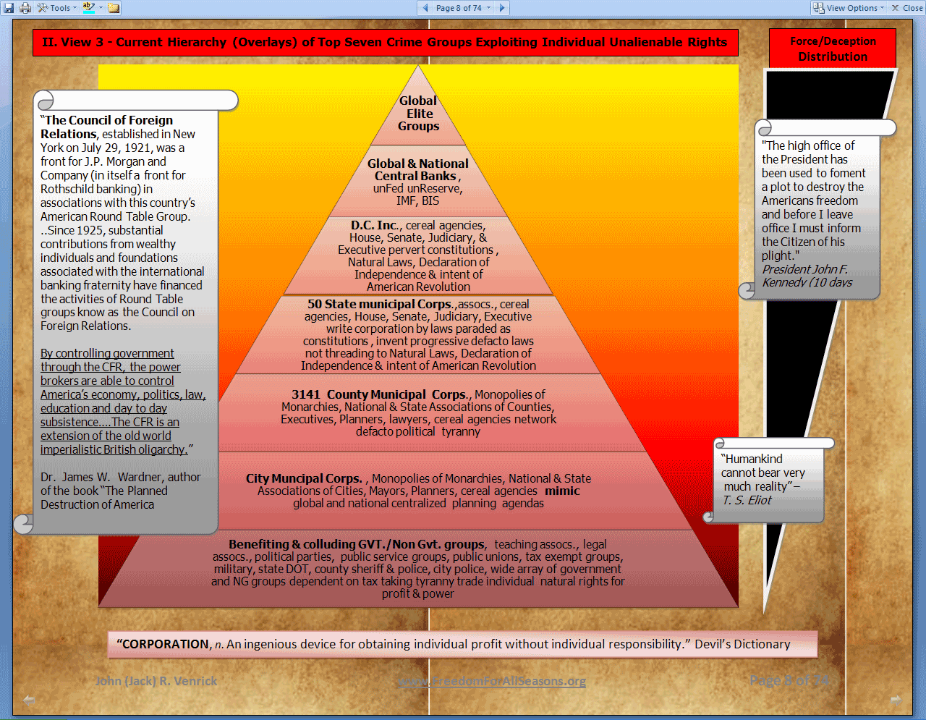
Awakening to The lowest common denominator - using false Flags to take property
Whatever side you are on regarding the labeling of people and/or their property for the purpose of taking property or unalienable rights for the “common good “ leads to a lowest common denominator.
The lowest common denominator of buffers, critical areas, sensitive areas, wetlands, dry lands, “man caused” global warming, “alternative” energy, “endangered” species, eminent domain, taxes, usury, regulations is the following.
Those who support these takings are either profiting or benefitting at least in their own mind in some way at the expense of others because they believe it is for the “common good and they can prove it”.
Those who oppose these takings strongly believe they are being unrightfully taken and can also prove the “science” of the taking is biased manipulated global to local agendas funded for profit and power.
That is to say, each side has created their own “reality” based on their perceived belief systems and can both ”prove” it.
What is the lowest common denominator of this paradigm?
Follow the money, power and the participants of the studies supporting these property takings! Without this funding and power no taking of property or unalienable rights would happen. The funding is in the form of false flags, debt, usury, regulations, taxing and tyranny including wars.
All of these tactics are criminal and prohibited in the highest fundamental and founding charters and acts of our land, Laws of Nature and Nature’s God, The Declaration of Independence and the spirit and success of the first American Revolution.
Those who support the takings strongly believe there would be chaos and anarchy unless the masses were highly controlled by social, environmental & monetary engineering. These groups are willing to war on others to “prevent social and environmental chaos”.
False Flag Events in History – You Decide
Which swill do you chose to drink or do you refuse to drink swill at all, “anarchy” or “buffers” or be beguiled?

Slide 18
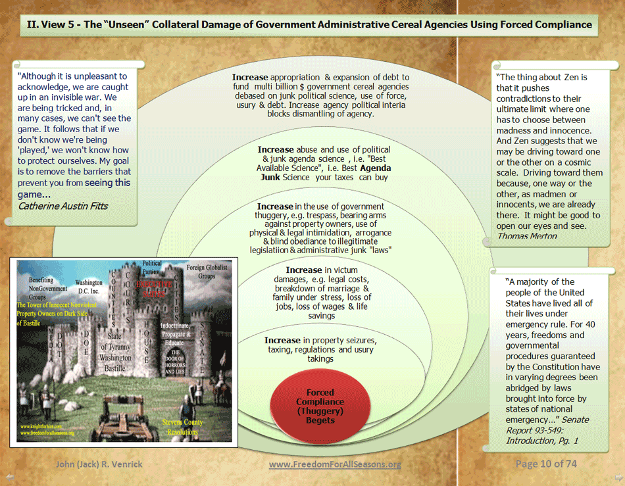
Follow the money to buffers
“Far from a grass roots movement, environmentalism is a big business, funded and directed by the leading families of the U.S. and European establishments
The scissors strategy works this way: 1) The Establishment's eco-militants generate panic (pressure from below) by warning about an impending "crisis" -- acid rain, ozone depletion, global warming, or threats from asbestos, alar, PCBs, etc. -- which is either a complete fraud or a gross exaggeration; 2) the CFR media and CFR politicians (pressure from above) advocate "solutions" to the "crisis" that invariably involves the expansion of government (more taxes and regulation) and the diminution of personal rights and economic opportunity.
Foundation Funding
  The Ford Foundation continues to follow the same revolutionary directives, and its grants to eco-fanatics advance the same treasonous objectives.
  The Rockefeller Foundations have shown a special affinity for the green alarmists, and there is scarcely an enviro-activist or eco-cause they have failed to fund.
  The John D. and Catherine T. MacArthur Foundation, now the largest of the foundations with over $3 billion in assets, has eclipsed Ford and Rockefeller in green giving.”
Leadership
  Strategic leadership and "research" are provided to the environmental movement by Establishment fronts such as the World Resources Institute (WRI), Resources for the Future (RFF), and the Worldwatch Institute (WWI). The president of WRI, and one of the green lobby's most influential figures, is Dr. James Gustave Speth (CFR), who also sits on the board of directors of the Environmental Law Institute and the Natural Resources Defense Council. Vice president at WRI is Jessica Tuchman Mathews (CFR). CFR members on WRI's board of directors include Matthew Nimetz (chairman), Robert O. Anderson, Robert O. Blake, Alice F. Emerson, Curtis A. Hessler, Thomas E. Lovejoy, C. Payne Lucas, Robert S. McNamara, Speth, and Russell E. Train.”
2012-12-20 United Nations Who Owns the Environmentalist Movement
2012-12-20 The New American - Pressure From Above and Below - October 4, 1993

Slide 19

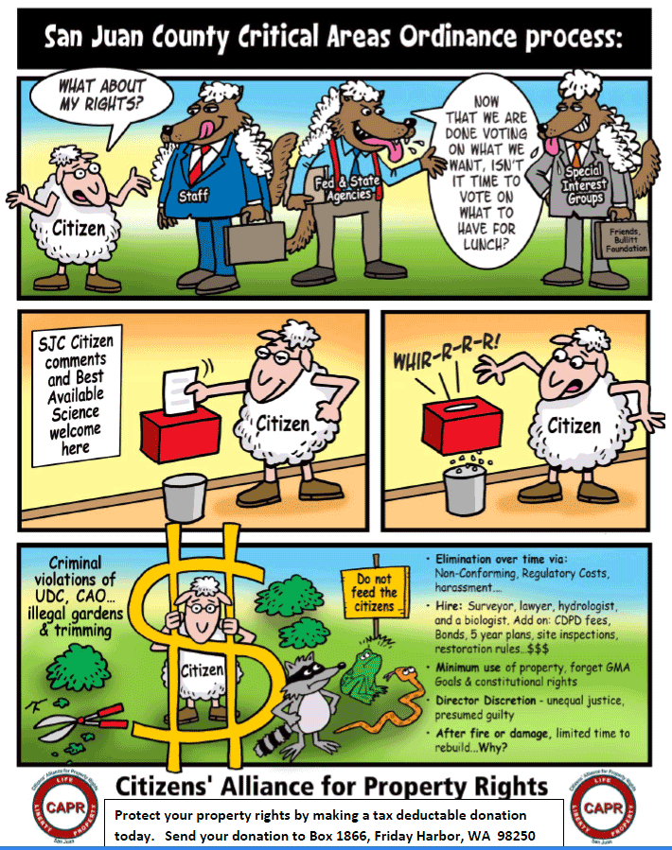
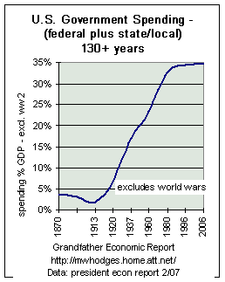
Introduction - to buffering belligerent buffoons
“The intelligent man {Staff, Fed & State Agencies, Special Interest Groups} who is proud of his intelligence is like the condemned man who is proud of his large cell”
Simone Weil
This presentation gives examples how our belief systems are fooled by labeling and forcing marginal and controversial research over rightful individual free choice.
“Dismissing “one man’s reality for the hypothesis of another while using political force is no longer in vogue even IF the hypothesis is correct. I true hypothesis does not validate the concept nor sanction any means to the ends of the hypothesis.
The originating email offers a study and a clue by USGS in 1999-2000 showing that the natural vegetation contributes more undesired nutrients to the water than man made lawns . This presentation shows more evidence supporting this theme. Thanks for sending this out Rick and CAPR.
The response to the originating email prompted me to develop this presentation, I thank that author for motivating me.
This presentation herein offers additional studies and material showing how political “science” and its brokered alliances have become the greatest masters of illusion, i.e. Growth and Shoreline Management.

Slide 20
Study #1 - Puget Sound Shoreline Science Review - by Dr. Don Flora (Independent) -
(highlights added) MUST READ STUDY (174 pages)
“In a world of fugitives
The person taking the opposite direction
Will appear to run away.”
T. S. Eliot
  Please find linked below the following 174 page study highlighted key statements herein along with the following excerpts. Dr. Don Flora does a beautiful job of summarizing the higher truths.
  Link to PDF below; #1 has my highlights and #2 does not, be patient for downloading.
  1. http://freedomforallseasons.org/FishMythReports/2012-11-13%20Puget-Sound-Shoreline-Science-Review%20(highlighted).pdf
  2. http://www.scribd.com/doc/31744984/Puget-Sound-Shoreline-Science-Review
  Key Excerpts
  “This is a good place to point out the massive equalizing effects of a massive {Puget} Sound and the
  ever-present ocean. Billions of gallons move to and fro, often swirling and mixing, within the
  Sound. Meanwhile the ocean continually puts even more billions in every day. Much of which
  then leaves, melded variously into the fresh water. If it were not so, the Sound would lose its
  salinity. For every gallon of fresh water in the central Sound there are nine gallons of ocean water.17”
  "So the ocean trumps all, including temperature. Also nitrogen (mentioned earlier), other
  nutrients, probably oxygen, and myriad organisms. No amount of upshore vegetation will alter
  tidewater temperatures hence invertebrate production, which in many cases responds to
  temperature.“
  "Bigger buffers and greater salmon production.
  Not likely, especially given the wide buffers already assigned to (pocket) estuaries. The number
  of salmon passing leaving the County is determined mostly by hatchery production, somewhat
  by local stream conditions.“
  "At a 2009 conference on bulkheads, a well-known researcher said, “it has not been confirmed in the field or the laboratory whether currents and sediment transport rates will increase or decrease in front of a hardened shoreline, as compared to a non-armored section of beach, and whether the sedimentary environment will be significantly modified.13“

Slide 21
Study #1 - Puget Sound Shoreline Science Review - by Dr. Don Flora (Independent) (continued) -
"The truth is more important than the facts."
Frank Lloyd Wright
Puget Sound Shoreline Science Review by Dr. Don Flora (Independent)
Key Excerpts Follow
"Drainfields are recited as a problem by providing nitrogen to tidewater, leading to deaths of bottom fish, notably in Hood Canal. Analyses have shown that the ocean puts 400 times as much nitrogen into the Canal as could be inserted by all the septic systems there. “Corrected” septic systems will be trumped by the ocean."
  "An estimated 15,000 dogs in Kitsap County generate about 10,000 pounds of feces daily. Dogs are a bigger problem, apparently, than stormwater in CSOs and out-of-whack septic systems, yet the “guide” offers no solution.“
  "...as Jim Brennan will recall. That consensus was that there is no relevant science on
  these subjects. This was not a call for “a precautionary approach” (p. III-42). Such an approach
  requires quantification of the risk and the cost of being wrong. With buffers we scarcely know
  the benefits, much less the range of outcomes nor their consequences, if any. Given this
  situation, a better approach is quite different – adaptive management. We’re already down that
  pike with buffering in a variety of circumstances and dimensions. It remains to determine what
  they were for, how well they worked, and whether alternatives do better at less cost.”

Slide 22
Study #1 - Puget Sound Shoreline Science Review by Dr. Don Flora independent – Continued
  "Wider buffers will hardly shield migrating salmon from predators.
  “The number of salmon leaving our waters for the Strait depends mainly on predation, of course.
  Predators include the mighty eaters - seals, sea lions and killer whales - plus eagles,
  cormorants, other marine birds, and other salmon."
  Wider buffers may have a mixed effect, by encouraging some nesting predators but also other
  creatures that attack those predators, like falcons, cats, raccoons, and coyotes. Eagles,
  already provided with buffer-content trees and a nearshore richly supplied with trees, while
  often choosing to perch on dock railings and idle on the beach, may not care. There is no
  evidence that herons are in decline nor, for that matter, increasing. Perhaps eagles, predatory
  on herons and growing in numbers, will be a limiting factor in herons’ welfare, rather than
  habitat.“
  "The relevance of “elsewhere” science from ocean nearshores has been questioned by a well known
  shoreline geologist,7 and I have explained that extrapolation from stream science is
  folly in a number of instances8."
  "By extension, we appear to agree that marine science relevant to Puget Sound is inadequate
  for intelligent near shore policy making."
  The troupe of fourteen who reviewed the study provided the answer: We don’t know.“

Slide 23
Study #1 - Puget Sound Shoreline Science Review by Dr. Don Flora independent - Continued
  "The Troupe’s Derogation
  Much of the troupe’s criticism comes from their incorrect perception that I wrote for a
  technical audience. The paper was intended for an audience of non-technical people including
  planners who may not have a marine science background.
  The troupe says the work lacks “rigor”. That word is straight from The Graduate Student’s
  First Book of Phrases. The statement may be offensive to the 20-some people, including
  scientists, who conducted the overall enterprise with detailed study plans, data accession,
  modeling, calculations, and analyses of the results. My (subsequent) role was merely to
  expand the consultants’ graphic analysis, form hypotheses, and examine correlation's."
  "It is significant that the troupe mentions little of their own research, nor puts forward any
  “more-correct” analysis of the data I used; nor did they provide data from some other source
  that would refute (or support) what I did.“
  "The Grand Slam
  A troupe member has said that my report “would not be considered publishable by any
  journal”. She may be surprised. She derided my peer reviews, which in fact were helpful. She
  warned that my paper must be “fought off”. She said my report does not contain “facts”.
  Perhaps graphics and statistical correlation's are not “facts”. The director of programs for
  People for Puget Sound has said that while my paper “is being cited at some local
  government meetings” it is too large [13 pages] for him to pass around. The troupe says it’s
  too short. One blogger applauded my objectivity; another questioned it.
  All because correlation is absent from 201 data sets."

Slide 24
Study #2 - Hood Canal Environmental Impact Comments by University of Washington To Puget Sound Partnership (111 pages)
This report was near 5 MB, you may link to my highlighted version here, be patient for downloading.
  http://www.freedomforallseasons.org/FishMythReports/2012-11-16%20UW_Hood_Canal_Enviromental_Impact_Comments%20(Highlighted).pdf
  If a submenu overlays the document delete it by clicking the X in the upper right box
"Hood Canal’s approximately 54,000 residents reside in an estimated 24,800 housing units (PSAT and HCCC, 2004)."
"A recent survey of 881 homeowners living within the watershed indicated that 86% of the households use either conventional or pressurized OSSs, consisting of a septic tank and drainfield (Christensen, 2005). In addition to this, wastewater from an unquantified number of commercial and public facilities is discharged to OSSs."
The first year of the study focused on five sites located at varying distances from Hood Canal. Nitrogen removal appeared to vary greatly among the five sites.
During Year 2, experiments were conducted at four study sites"
The overarching goal of the Hood Canal Onsite Sewage System Nitrogen Project was to assess the extent of N removal from OSS effluent occurring in the sub-surface down-gradient of OSSs within the Hood Canal watershed. This study was conducted over two years and characterized nitrogen removal at eight sites.
"The questions guiding this research were:
  1) To what extent is N {nitrogen} in OSS {onsite sewage systems} effluent removed via denitrification as effluent released from near-shore OSSs travels into Hood Canal?
  2) What factors limit N removal from OSS discharges in the subsurface environment immediately adjacent Hood Canal?“
"A preliminary assessment by the United States Geological Survey (USGS) (Paulson et al., 2006) identified marine contributions as the dominant source of N, followed by inputs from rivers and streams, regional groundwater, onsite wastewater treatment systems, atmospheric deposition, and other sources"

Slide 25
Study #2 - Hood Canal Environmental Impact Comments by University of Washington To Puget Sound Partnership (continued)
"Nitrogen inputs to Hood Canal from deep seawater exceed the human-derived N contribution.“
"This study found that there is no obvious typical OSS {Onsite Sewage System} environment or scenario that can be generalized to the Hood Canal watershed.“
"This field study of denitrification supports the conclusions of previous field studies that the occurrence and extent of denitrification is spatially specific and highly variable.”
"A database of domestic drinking water wells was compiled using DOE’s public records. The criteria for well selection were that the well was located in the Hood Canal watershed and that it was relatively shallow, with a depth less than 60 feet. Well owners were contacted by mail and then by phone and were assured that the data collected in the study could not be traced to specific wells. Twenty-six homeowners granted access to their wells, and single samples were collected from each well."
  Jack's comments - the test results of the water appear to be normal to me, i.e. the conclusions seem to be intentionally obtuse

Slide 26
Shoreline Management Birth
“To define a thing is to substitute the definition for the thing itself.”
Georges Braque
INITIATIVE TO THE LEGISLATURE NO. 42
(Regulating Shoreline Use and Development) Filed September 21, 1970 by the Washington Environmental Council. Refiled as Initiative to the Legislature No. 43.
INITIATIVE TO THE LEGISLATURE NO. 43
(Regulating Shoreline Use and Development) Filed September 25, 1970 by the Washington Environmental Council. 160,421 signatures were filed on December 31, 1970 and found sufficient. The measure was certified to the Legislature on January 29, 1971. The Legislature passed an alternative measure No. 43B, now identified as Chapter 286, Laws of 1971, 1st Ex. Session, which became effective as of June 1, 1971. However, as required by the state constitution, both measures were submitted to the November 7, 1972 state general election. The votes cast on the original measure and the alternative proposal were as follows: For Either: 603,167 Against Both: 551,132 Prefer No. 43: 285,721 Prefer No. 43B: 611,748 As a consequence, Alternative Measure No. 43B prevailed which sustained Chapter 286, Laws of 1971, 1st Ex. Session, as law.
Extract from WEC website:
"With support from our champion legislators, the Coalition prevented what would have been historic rollbacks to major environmental protections, including the Growth Management Act, the Shoreline Management Act, the State Environmental Policy Act and the state energy code." WEC - http://wecprotects.org/legislation
The Washington Environmental Council (WEC) started the regulation of shorelines in WA Inc state in 1970 by "champion legislators" with a "Coalition", please see below extracted from http://www.sos.wa.gov/elections/initiatives/statistics_initleg.aspx.
Here is the WEC coalition - http://wecprotects.org/about/member-organizations
Here is the WEC Board - http://wecprotects.org/about/board/board-1
  15 staff members and 22 board members with 6 lawyers/attorneys, 18 hits on "law" for these 22 board members
  17 hits on "policy" for these 22 board members, 7 hits on the root word "plan", e.g. planning
  1 member has a BS in Forestry from the University of Vermont
      "She enjoys multidisciplinary projects that blend science, planning, policy development and public outreach. She successfully manages complex technical studies and permitting efforts for state resource agencies, cities and counties, transit/transportation agencies, utility providers, industry, non-profits and private developers"

Slide 27
Creative Science + Creative Legislation + Creative Courts = No Science, a.k.a. political unscience
“He who carves the Buddha never worships him.”
Chinese Proverb
You can see that the Initiative NO. 43 "vote" above was very close, 603,167 for and 551,132 against.
You can see there was an attempt to rollback these takings.
Also Florida has repealed their smart growth - http://www.freedomforallseasons.org/RuralCleansing/2011-10-10%20Florida%20Repeals%20Smart%20Growth%20Law.pdf.
Many cities are opting out of smart growth polices once they learn the truth and see the big picture thanks to freedom fighters such as Tom DeWeese, Michael Shaw, Beverly Ekman, Michael Coffman, Ph.D, Michael J. Chapman and a rapidly growing revolution taking back all our long lost rights.
Private property and creative threatening regulation through abutting public property
    Private property is a rightful sanctuary long established by America’s highest fundamental laws of the land, i.e., the Laws of Nature, Declaration of Independence and the spirit and success of the first American Revolution.
    Private property unalienable rights cannot be redefined by public or private corporations, planning policies or public votes by the “majority” contrived by the minorities, e.g. NGO’s, global elites.
    “Public” use of public property around, near or abutting private property and business owners is a potential threat and act of encroachment which must have the private property and business owner's express approval.
    Premeditated planning upon any public or private property may be seen by the property or business owner as an act to threaten or harm the property owner’s family or livelihood. Each private property owner must be consulted and must approve any act of “planning”.
    So called public meetings are a ceremony and ritual to pacify the apathetic public and any challenges in COurts, not true and honest individual contracting with the affected property and business owners.

Slide 28
Creative Science + Creative Legislation + Creative Courts =
No Science, a.k.a. political unscience (continued)
“Facts are the enemy of Truth”
Miguel Cervantes
Here are some more examples of how the State and it's municipal constitutional children use the consensus approach to make the "right" decisions for themselves NOT the property owners.
The Illusion of Local Control
How To Handle Predetermined Consensus Meetings
Jefferson County Public Participation Strategy by Consensus - Shoreline Mgmt Plan
"Natural buffers", "sensitive areas", "critical areas", "shorelines" are all in the same class with other green myths created by committed men and women who have much to gain and little to loose in taking private and public property.
  Using the "common good of all" , e.g. “safety and health” which is the extent of twisted rationale political and scientific minds can conjure up.
  The profile of taking property is always the same, i.e. the same characters, same agendas, same lies, same double standards, same fragmented facts.
  It was the same lies for "Man caused" global warming, "Alternative Energy" and "Sustainable Development" .
  i.e. It’s the same global to local man caused scams with the same tactics, funding sources, and government and non government groups.
The 9 sites studied around Hood Canal (University of Washington Study No. 2 above) hardly make statistical significant conclusions on a population the size of 54,000 residents around such a large mass of land and water as Hood Canal. Using 2.6 as the average house size, this is roughly 20,769 homes. Lets say 10% of these are near the water on septic systems, i.e. 2100. My sample size chart shows you need 1863 samples for a confidence of 99% with an accuracy of +/- 1%. The truth has become what they don't say. They tell you what they want you to believe using fragmented incomplete data which even then yields inconclusive results.
This is how strong bias and belief systems operate especially properly funded. The real pollution in Puget Sound and the Hood Canal is the political, legal and “scientific” filth that lays like a fog over the minds and hearts of all of us.

Slide 29
Creative Science + Creative Legislation + Creative Courts =
No Science, a.k.a. political Unscience (continued)
“You are lost the instant you know what the result will be.”
Juan Gris
Creative high courts have wrestled with how to discern a hypothesis from scientific/engineering/statistical conclusions. This is a precedence setting case worth summarizing.
It is interesting that the politician(s) who creates this junk legislation and the judge(s) who end up deciding the case are both incapable of understanding the science and engineering because they do not have these qualifications. So in turn both parties create more rules to corral and herd the theories, hypothesis and axioms into political and legal buckets with the appropriate accepted forms of bias and punishment of the era. Never does it enter into their heads that the independent property owners, scientists and engineers already know what the answer is and have already decided if they are going to obey or not.
  Dubert v. Merrell Dow Pharmaceuticals, Inc. - The Battle Over Admissibility Standards for Scientific Evidence in Court
  Link here to view case with my highlights - http://www.freedomforallseasons.org/FishMythReports/2012-11-19%20Admissibility%20Standards%20for%20Scientific%20Evidence%20in%20Court%20-%20HiLighted.pdf
  "Accordingly, “[s]cience advances primarily by replacement, not by addition.”9 The Bayer group also emphasized that scientific facts are socially and culturally constructed. In the words of Gould, scientific facts are not “unsullied, pristine bits of truth because culture influences what we see and how we see it.” {Jack's comment: this is profound right on, i.e. this is the result of junk science and professional groups and academia arrogance of wanting to force a groups consensus across their particular field(s). The ego never stops expanding until the heart and the soul start turning on the lights.
  "Moreover, scientific conclusions, the Bayer group argued, are not as certain as the courts assume. The Bayer group criticized the lower court’s assumption that just because the epidemiological studies published thus far found no link between Bendectin and birth defects, there could never be a study which indicated such a causal relationship."
  " Finally, Bayer et al. argued against the use of peer review and publication as a litmus test for admissibility. While they understood the temptation for the court to “seize upon what it apparently took to be a quick and easy ‘Good Housekeeping Seal of Approval’”for general acceptance, they did not think that peer-reviewed publication was an appropriate litmus test. In short, the Bayer group believed that a more liberal admissibility standard would better reflect science as they understood it."
  You can read quickly read of the case summary linked above especially the highlights and come to your own conclusions. Both sides presented excellent points.
  The court made the right decision, it was unanimous however, two of the judges did not venture beyond their legal fence.
The moral of the story is, land use cannot be taken to a barber shop for a trim every time some group of special interest wants to force YOUR property to look better in their narrow minded eyes. This creates a tidal wave of taking, confusion, creative enforcement upon the property and business owners who increasingly have less and less due process to have their rights reestablished. Force never works and is never used in a true and honest free limited Republic.

Slide 30
GMA I and II Birth
"The definition of a mad man and a committed man becomes blurred".
Author Unknown
The GMA (Growth Management Act) started the CAO (Critical Area Ordinance)
“The Tortuous Legislative History of the GMA - extract from a University Puget Sound of Law - http://digitalcommons.law.seattleu.edu/cgi/viewcontent.cgi?article=1392&context=sulr
The GMA was not the elegantly designed, finely-honed product of a law revision commission adopted verbatim by a grateful legislature. The fierce legislative gauntlets run by GMA I and II left countless scars: politically necessary omissions, internal inconsistencies, and intentionally vague language to defer to another day the moment of truth. Resulting uncertainty about the meaning and effect of important and controversial elements of GMA I and II eventually will be resolved by the Growth Planning Hearings Boards, the courts, or, perhaps, the legislature. To resolve numerous interpretive issues, the boards, courts, and parties before them will have to divine what the legislature meant from the GMA's extremely complex legislative history."
"The socialists attempted to remold human nature. Their failure is further evidence that the nature of man is universal and unchanging. Man is a rational animal, a social animal, a property owning animal and a maker of things. He is social in the way that wolves and penguins are social, not social in the way that bees are social. The kind of society that is right for bees, a totalitarian society, is not right for people. ...humans are social, but not eusocial”
(eusocial defined - http://encyclopedia.farlex.com/Eusocial)
“In a strong 8-1 decision, the Washington State Supreme Court has ruled the Growth Management Act (GMA) does not require mandatory buffers along streams and rivers. The Court also ruled the GMA only requires that local jurisdictions “protect” critical areas, not “enhance” them, and that the GMA does not require local governments to impose mandatory riparian buffers.”

Slide 31
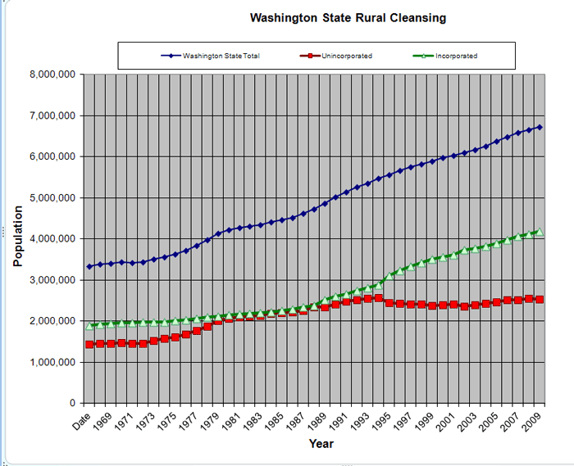
The growth management lie – part 1 of 3 how state citizens are herded into ant and bee colonies
"The socialists attempted to remold human nature. Their failure is further evidence that the nature of man is universal and unchanging. Man is a rational animal, a social animal, a property owning animal and a maker of things. He is social in the way that wolves and penguins are social, not social in the way that bees are social. The kind of society that is right for bees, a totalitarian society, is not right for people. ...humans are social, but not eusocial”
(eusocial defined - http://encyclopedia.farlex.com/Eusocial)
2012-01-21 Voluntary_Stewardship_Program_Letter
2011-10-21 White House Exec Order on Rural Council - Agenda 21 Sustainable Death
2011-10-10 Florida Repeals Smart Growth Law
2011-09-19 CAPR San Juan County WA Letter by Frank Penwell
To San Juan Planning Commission
2011-07-25 Fact Sheet 4 GMA Goals- 7-25-11 Frank Penwell CAPR San Juan
2011-02-21 Your Hometown & the United Nations Agenda 21 - New American
2011-02-06 Late Post 11-15-04 Unwritten Rules and Unfinished Business Perkins Coie (Must Read)
2011-02-06 Late Post 9-27-10 SMA and Public Access
2011-01-18 Capr Announce Public hearing for GMA Opt Out HB 1094
The Seven Lies of Zoning - TLP
GMA FLAWS by Ron Ewart
2011-01-15 Can America Survive Its Large Cities by Ron Ewart
2010-11-1 Washington case law shows that this test of causation is morphing into a less scrutinizing means-end test of rationality.
2010-10-29 Smart Growth NGO Benefactos UrbanTrans
2010-07-18 New Article on the GMA, CAPR v. Sims and takings law
2010-05-02 State of Washington Growth Management Hearing Boards
2009-03-13 [proprights] House lets GMA_SMA bill die
2009-01-24 Washington State House Bill 1490 - 2009 Legislative session
2009-01-18 WA State GMA Staff, Website & Takings Plan
2009-01-18 OSF ALERT! – Shoreline Master Program

Slide 32
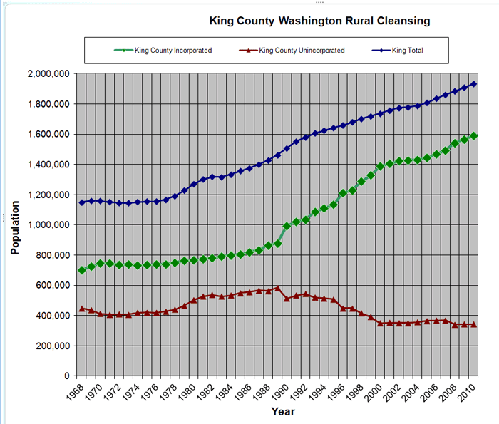
The growth management lie – part 2 of 3 population control by buffer brinkmanship
“The ultimate standpoint of Zen…is that we have been led astray through ignorance to find a split in our own being, that there was from the very beginning no need for a struggle between the finite and the infinite, that the peace we are seeking so eagerly has been there all the time.”
D. T. Suzuki
2009-01-16 PLANNING COMMISSION CONTACT for SHORELINE MGMT COMMENTS
2009-01-16 [proprights] Legislative goodies of the day
2009-01-16 Support Clean Water and Shorelines Protections in Jefferson County
2008-11-30 International Council for Local Environmental Initiatives - Know your enemy
2008-11-30 Central PS Growth Planning Hearings Board
2008-08-14 [proprights] (Thurston) County wins growth ruling in state Supreme Court
2008-03-08 Subversion of the Intent and Clear Language of ESHB 1933
2008-03-06 Washington State GMA STAFF, WEBSITE & TAKINGS PLAN
CTED Prepares to Release the Scope of Work for WAC Update Process
2007-10-08 Property owners prevail in Supreme Court -
GMA does not require mandatory buffers
2007-07-27 The Hidden Cost of Planning
2007-06-10 The Road to Serfdom
2007-03-16 Government Eating The Master's hand
2007-02-04 Take a look at what GMA created
2007-02-04 Oldies and Goldies
2007-02-04 Brave Old World
2007-1-17 How Freedom Becomes Blighted in the City
2007-01-17 [proprights] CONSERVATION FUTURES
2006-02-01 [Capr-discussion] Excellent piece summarizing the GMA
2006-01-19 HB 2906 Greater GMA Board Accountability
2006-01-18 HB 3016 Senate Confirmation GMA
2006-01-18 HB 2906 Greater Accountability for GMA
2005-12-29 GMA by Government Plain Wrong
2005-11-20 No Value seen in free habitat plan
“Buffers at best are an act to make high density areas aware of their own "spill over" from rat packing humans. However, the real crime is not inadequate buffers, the crime is in the eusocial planning which created the problem and the pressure on the “buffers” by rat pack humans like ants and bees using global sustainable development central planning public policies like UN Agenda 21.”
FreedomForAllSeasons

Slide 33
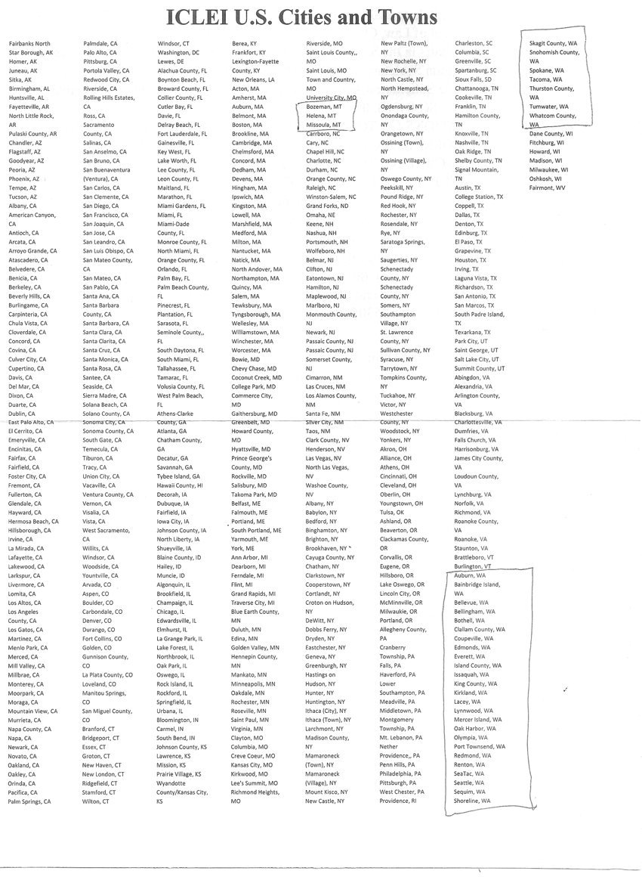
The growth management lie – part 3 of 3 banishment of population by buffers
Resolution to Protect Citizen’s Property Rights Download
ICLEI IS AN UNITED NATIONS FRONT GROUP –
GET THEM OUT OF YOUR TOWNS
  If YOU see your city on here call your neighbors, mayor and council and get them out ASAP. These are the seed cities where this collectivism virus is planted and then the dis..ease quickly spreads to adjoining county and city municipal corporations and subdivisions through complicit planning associations.
2012-12-23 Alabama Protects Citizens From Agenda 21 Implementation - Investors_com
2012-11-19 Late Post Opinion Misguided land-use regulations push middle class out of King County Seattle Times Newspaper
2012-11-18 Activist Post WA farmers block federal drones and Agenda 21
2012-10-10 Rejection of UN Agenda 21 Ramping Up Weekend Morning Buzz
2012-09-22 Democrats Against UN Agenda 21 See Comment on Steve Tharinger's Facebook)
2012-09-20 Prison Planet_com » U_N_ Conquers Texas
2012-08-29 White House Executive Order On Rural Council
2012-08-29 UrbanSurvival170Gallons
2012-07-11 Agenda 21, UN's Sustainability Measure Banned By New Hampshire House
2012-07-11 UN Unveils Agreement Detailing global Governance
2012-06-12 DeWeese Letter Agenda 21 - Conspiracy Theory OR THREAT
2012-02-03 Is Urban Planning Creeping Socialism
Click here to link to a full view

Slide 34
“Primitive Ideas”: Protected Area Buffer Zones and the Politics of Land in Africa
“Primitive ideas regarding buffers - .. “the meaning of traditional and the identification of traditional beliefs and practices related to land ownership and access is never straightforward. The process of identifying customary property rights is to a great degree a political one, because it involves questions of the power to narrate history, to define tradition, and in the process to make claims to land and resources.”
“In general, buffer zone proposals suffer from a failure to recognize, let alone analyze, unequal relations of power and how they relate to land and resource access and, ultimately, the efficacy of conservation policies. This is a dangerous oversight as these proposals remain subject to the same sorts of politically-charged questions - how is access controlled, to what degree is the institution of control seen as legitimate by the community, how is the range of uses determined, and who has authority for monitoring compliance..”
It is thus quite likely that many of the proposals and projects reviewed here will result in increased conflicts over land and resources, both within communities and between local communities and the state.
Avoiding the temptation to either romanticize or demonize rural peoples in Africa, perhaps we can build a dialogue which is truly mutual and initiate institutions and policies that actually empower people to control their lives and improve the conditions under which they live.
First, we need to recognize that past and present conservation policies are complicit in creating the climate of land tenure insecurity within which many rural African communities operate. The establishment of virtually every national park in sub-Saharan Africa required either the outright removal of rural communities or, at the very least, the curtailment of access to lands and resources. As a result buffer zones extend the authority of the park to monitor and restrict land and resource uses of populations already displaced by protected areas. Policies need to be reconceptualized.
Finally, we need to understand how the development interventions in buffer zones relate to conservation. Many of the projects reviewed are designed not to improve livelihoods, but merely to defuse local opposition. This is a very short-sighted and short-lived `solution' and simply `buys' the support of (some segments of) local communities rather than integrating conservation with development. “
http://www.freedomforallseasons.org/CriticalAreaOrdinanceMythEmail/Primitive_ideas%20re.%20buffers.pdf
Abstract of “Primitive Ideas”
“This article (link below) critically evaluates participatory, integrated conservation and development programs in Africa, focusing on protected area buffer zones. I argue that, despite the emphasis on participation and benefit-sharing, many of the new projects replicate more coercive forms of conservation practice and often constitute an expansion of state authority into remote rural areas. I suggest that the reasons for this state of affairs can be traced in part to the persistence in conservation interventions of Western ideas and images of the Other. These stereotypes result in misguided assumptions in conservation programs which have important implications for the politics of land in buffer zone communities.”

Slide 35
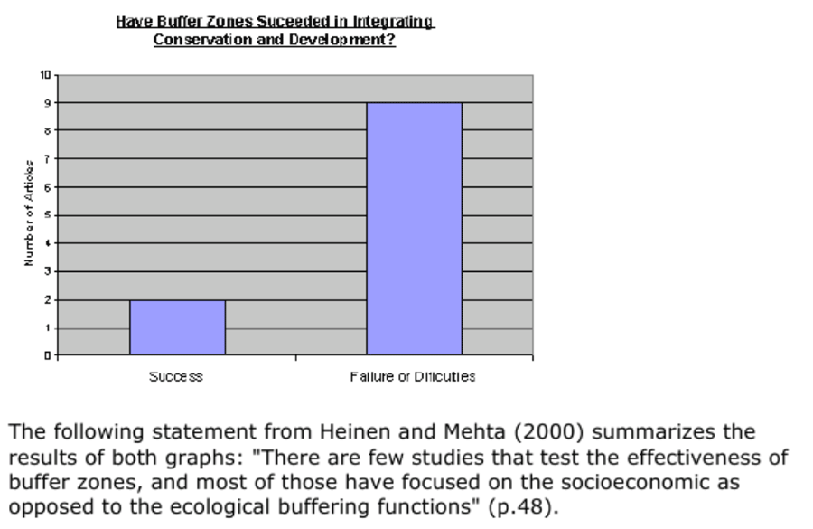
Buffer zones around protected areas: a brief literature review
Key Points
“Origin of Buffers is UNESCO in the 1970’s
Wells and Brandon (1992) refer to the importance of analyzing the definitions. They state that “current buffer zone definitions are inconsistent and overlook practical problems, and this precludes their implementation in all but very limited circumstances” (p. 27)
“Rather than representing a new approach, many buffer zone project and other ICDPs more closely resemble colonial conservation practices in their socio-economic and political consequences. In actuality, many buffer zones constitute a geographical expansion of state authority beyond the boundaries of protected areas and into rural communities. (p. 564)
…Wells and Brandon (1992) believe that one of the most serious problems with buffer zones is the implication that the limited benefits that can flow to local people can change their behavior, reduce pressure on the plants and animals in the protected area, and thereby enhance the conservation of biological diversity. It is difficult to find logical reasons for this expectations. (p. 27)
Neumann presents examples from Madagascar, Tanzania (Selous Game Reserve) and Cameroon (Dorup National Park) in which the establishment of buffer zones resulted in “new forms of state intervention and restrictions on land use” (p. 564)
…there are differences between the idea behind buffer zones in the Men And The Biosphere (MAB) program and other approaches to them. Biosphere Reserves envision buffer zones as places in which experimentally sustainable development alternatives can take place. There is even the intention to “ensure that all zones of biosphere reserves contribute appropriately to conservation, sustainable development, and scientific understanding” (UNESCO, 1995, p. 4)
It is also clear that scientists do not agree on the role of buffer zones, and for this reason confusion arises on what the objectives of buffer zones are.”
Have Buffer Zones Succeeded In Integrating Conservation and Development?
Failure or
Difficulties
Source: http://escholarship.org/uc/item/02n4v17n#page-3

Slide 36
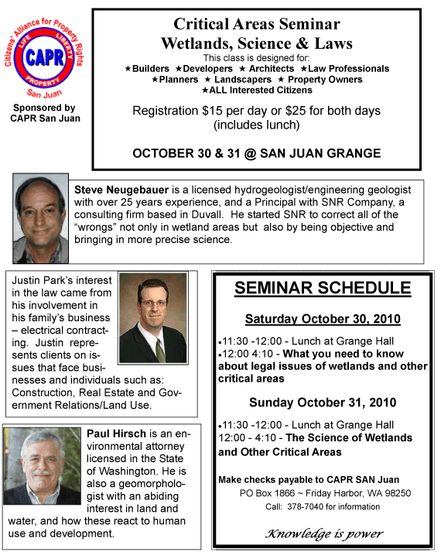
The sensitive (sAo) and Critical area ordinances (cao) government lies exposed (Mutants created by GMA)
Link to Steve Neugebauer’s presentation “Critical Areas Seminar Wetlands, Science & Laws (Must See)
Link to Jack’s notes of seminar
Summary of Seminar Notes
“Cannot take without paying includes wet and water lands
No definition of “Stream” in Forest Practice Act (1974)
  Term misidentified
  They make everything a “Stream”
GMA (Growth Management Act) started CAO
Jack’s side comment: “In a true & honest Free Republic, the Citizens manage the growth of government NOT visa versa.”
CAO is a vehicle for Municipals to make $ from you, great $ maker for counties
$142.25/hour Washington King County DDES fee for permits
DDES claim do not meet state and federal regulation
Muni’s discharge storm water into local lakes causes them to flood lake residents
Citizen law suits against Olympia, 5 law firms used with costs of $37,500/day X 13 {suits} & $800 million in fines
Anything you do can trigger CAO
Federal government dominates the State
None of state or Fed manuals have BAS!
“Wetland Scientist” have no licenses or requirements.
Washington King County uses soil color chart to type soils which can’t be used because…
  Andic soils most common in Puget Sound and Baslic mostly black, i.e. color does not make difference, need more refined methods.
Wetland scientist shot down in Legislature because he/she was not licensed
Government is facing fixed + trespass clauses with treble damages with intent to trespass
Key – New stream definition submitted by Steve Neugebauer, if passed would eliminate 98% of property owners problems
Congress never had intension of CAO to apply to pasture, CAO was for bog part of wetland definition
Wetland “scientist” have NO qualifications , e.g. Pierce County has minimum
They (government) are clueless on hydrology
Wetlands are deep water habitats
Commerce Clause Federal – almost shot down, used for taking everything, e.g. waters of U.S.
Commerce Clause Federal – almost shot down, used for taking everything, e.g. waters of U.S.
DOE considers rain as “Waters of the State”, i.e. they own the rain
Soils and soil typing is misused to determine “wetlands”.”

Slide 37

the county Voluntary stewardship program lie exposed (Jack’s underscore added)
Citizens’ Alliance for Property Rights-
Spokane Chapter
Kevin Paulson-CAPR President
10321 E. Bigelow Gulch Rd.
Spokane, WA 99217
January 12, 2012
Dear County Commissioners:
The Spokane County Chapter of Citizens’ Alliance for Property Rights (CAPR) has some concerns with the proposed Voluntary Stewardship Program (VSP). The VSP was created when Governor Christine Gregoire commissioned Bill Ruckelshaus to protect environmentally sensitive areas in our state while preserving farm land. Please include this letter as public testimony that our chapter is not in favor of the VSP.
As you may know, John Koster, who is the immediate Past President of the WA State Association of Counties (WSAC), is also strongly opposed to the VSP. He said the program is rife with potential problems. Koster said the WSAC should not be advocating for or against the program. He cautioned that “counties should exercise extreme caution and consider their participation carefully.”
We understand that by January 22, 2012, every county in Washington State must declare its intent to opt into the VSP or continue to comply with existing law in the Growth Management Act (GMA).
The supposed intent of both programs is to protect Critical Areas Ordinance (CAO) on agricultural lands. In our opinion, both options violate private property rights and are unconstitutional. What authority grants the GMA and now the proposed VSP from not being superseded by the constitutions of the state of Washington and the United States? Our constitutions are meant to protect us from this sort of government overreach. Mandates from both the VSP and the GMA deprive rural American farms, ranches, and timberlands from profitable use, and are counter to everything a free society stands for.
In addition to these concerns, why should another program or bureaucracy micromanage rural property or private farmland in our state? Currently, the USDA’s Natural Resources Conservation Service (NRCS) assists rural American farmers to help preserve and protect their soil from erosion. These programs have largely been voluntary, but are required in order to participate in the USDA’s Farm Service Agency (FSA) program. An extremely high percentage of America’s farmers participate in the FSA programs.
Through the current system, farmers have implemented direct seeding, reduced tillage, reduced airborne dust emissions and soil erosion. Furthermore, new technologies such as Global Positioning Systems (GPS) are helping to guide farm machinery and thereby reduce overuse of fertilizer, agricultural chemicals, and seed. Input costs have gone down and yields have shown an increase as overlapping of machine passes are reduced with the use of GPS.
We already have in place a very efficient system of preserving and protecting America’s farms, ranches, and timber lands from degradation. Why would another expensive and stringent layer of policy makers from a desk removed from rural America make our current programs more effective? From the Spokane County Citizens’ Alliance for Property Rights perspective, this is just another attempt to remove control of natural resources from those who work the land.
There appears to be nothing voluntary about the Voluntary Stewardship Program! We will have increased regulatory control, implemented from afar by people who do not understand the issues like the farmers and ranchers on the ground. Thomas Jefferson warned us, “Were we directed from Washington when to sow and when to reap, we should soon want bread.”
Another bureaucratic layer of administration with enrollment in the VSP to protect rural America from the Growth Management Act does not make sense. It is time for the Growth Management Act to be revised or for counties in rural Washington State to opt out of the GMA.
Whatcom County has decided not to opt into the VSP. Their county attorney found ways the VSP could be appealed to the Growth Management Hearing Board. Even if you have already opted into the VSP program, further review should be made as to whether this program will provide temporary relief or further burden our courts with lawsuits.
A better option than opting into the VSP is to eliminate or correct the GMA so that regulatory restrictions which affect farming, ranching and forestry activities on agricultural lands are eliminated. We currently have voluntary conservation programs in place and the VSP appears to be a move to implement mandatory regulations upon agriculture. Nothing good has ever come from the Ruckelshaus Commission, and that includes the VSP.
Cordially,
Kevin J. Paulson
CAPR President
Spokane Chapter
(509) 922-5048

Slide 38
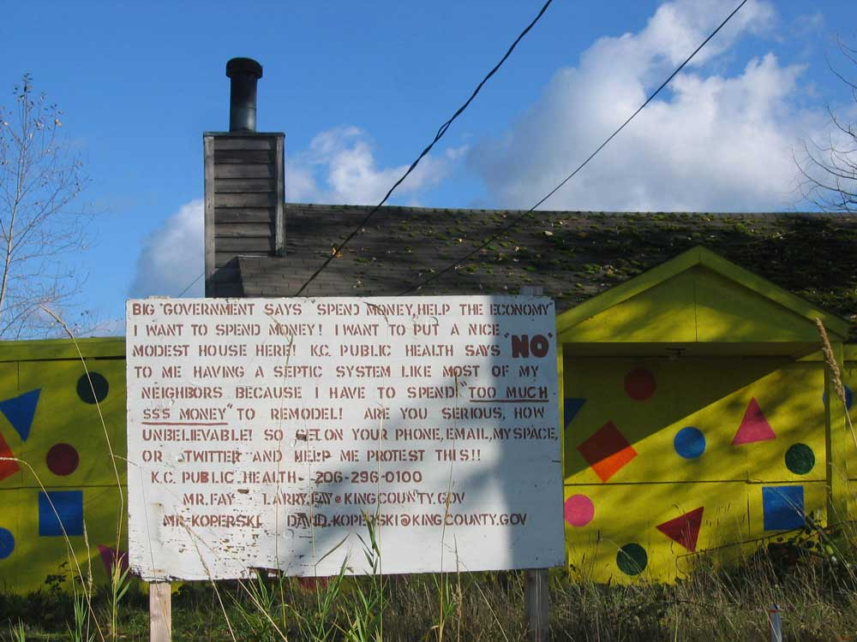
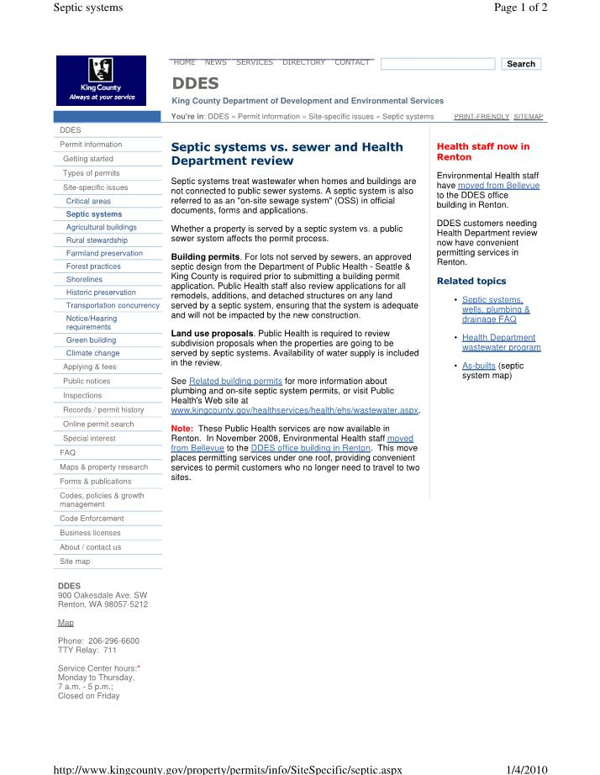
regulation LIES
If you repeat a lie often enough people will believe it is the truth . If you call the lie a regulation, they will believe they must be regulated so others won’t lie.
Enumclaw Washington King County Municipal Corporation
This house is 5 minutes from me and has been shut down by King County Municipal Corporation in Seattle all while they spend $5 million to reroute a little creek flowing into the White River called Boise Creek 3 minutes from this house, please see next slide.
And then the creek level dropped so low the county thugs were caught bucketing the water from the old creek bed to their man made bottomless swale, it now seems to work in high water.
Municipal corporation sub divisions are originally free choice sharing of infrastructure NOT self serving, self bestowing and self generating green global to local monopolies creating codes (swill) forced down the Citizens throats to give Muni revenue to escalate their takings based on junk science and enforced largely by employees who largely have no professional credentials.
The vast majority of municipal services you see in this country are oppressive, regressive, unproductive, unwanted and have no economic value added, i.e. for the “public common good”.
A true and honest free Republic operates thru a free market by free choice. Home owners cannot be forced or trespassed upon to upgrade their property because of the whims of some county employee hack who has no jurisdiction or authority or professional independent standing credibility with the sovereign state Citizens other than by threat of violence upon that property owner.
The dirty little secret regarding municipal monopoly corporations, a.k.a. political subdivisions, is they are advisory ONLY not adversarial. A free and limited Republic cannot extend its jurisdiction and/or authority by the use of violence upon the sovereign state natural born Citizens. Municipal subdivisions are simple coops NOT Monarchies.

Slide 39
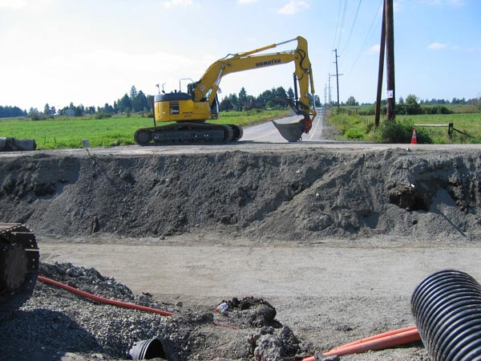
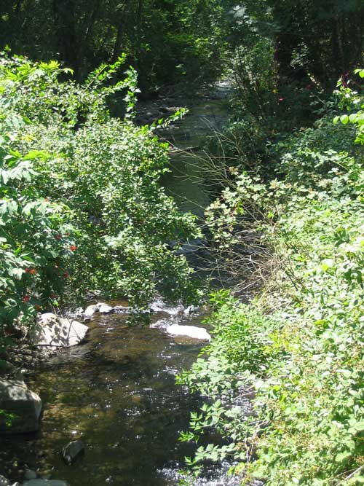
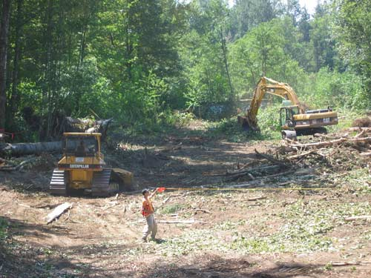
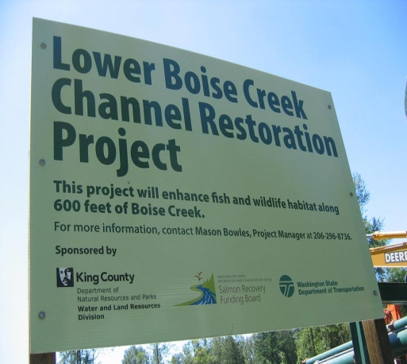


More State and Municipal madness – The Fish lie
In a true and honest Free Republic no “public” action can take place unless the all the property owners impacted by the action individually contract with the public or private agency taking the action”
FreedomForAllSeasons
SE 416th & 244th Ave. SE
Enumclaw, WA Inc.
Estimated $5 million dollars & counting to reroute little Boise Creek (below Left to Right) and still the natural creek resists rerouting to higher ground. King County sends bucket brigade to force natural creek to run uphill in dry season. King County employee on site told me this project was providing jobs, i.e. to the green government and THEIR green NG contractors.
About $1 million for one fish roundabout , extravagant waste billed to local rural property owners they never approved! Also one at the next corner, dozens in state.
How King County Municipal Corporation and complicit colluding nongovernment groups are making money by cleaning up the mouth of this stream and rerouting it under the myth they are saving the fish....while the hard truth is they are attracting less fish and starving those few who do return according to the studies on next page. In other words, they are doing this for the grant money which is central banking debt created to confiscate the natural resources of the American Citizens, then charged back to them through debt, usury, inflation, taxes and more regulations, i.e. lies.
President
Eisenhower
1953-61
Are you having a hard time believing this could be true, check it all out and more than you may be able to stand - http://www.freedomforallseasons.org/FreedomFromFishMyths.dwt.asp

Slide 40
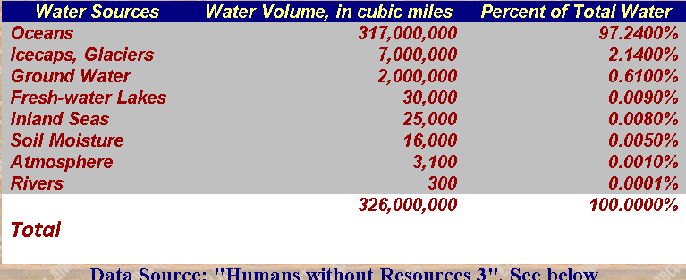
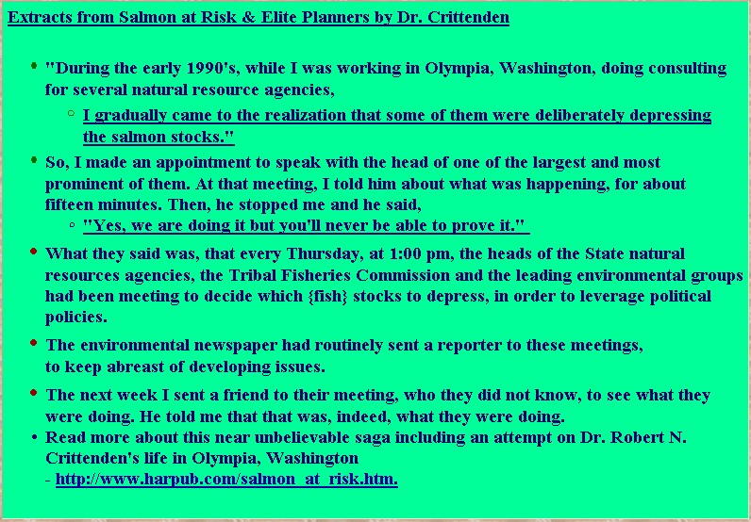
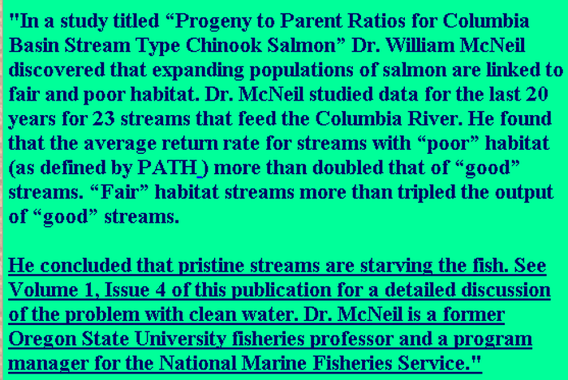
Buffering The fish is based largely on myth - Part 1 of 2
http://www.freedomforallseasons.org/FreedomFromFishMyths.dwt.asp

Slide 41
Buffering The fish is based largely on myth – Part 2 of 3
“The ego, being a flimsy construction and being bound up in time and space, will have to fall apart. The ego, in fact, continuously falls apart and has to be reinforced by vanity, greed, jealously and evil.
Janwillem Van Der Wetering
http://www.freedomforallseasons.org/FreedomFromFishMyths.dwt.asp
Extracts from Salmon Without Rivers" by Jim Lichatowich
Point 1 - "As we have seen, many natural factors harming Columbia Basin salmon populations have been on the rise since the 1970s. More generally, looking over periods from 10,000 to 100,000 years, the populations of many marine animals exhibit huge fluctuations. Examples include Dungeness crabs, Maine lobsters, Pacific anchovy, and many other species.
Point 2 - "Fundamentally, the salmon's decline has been the consequence of a vision based on flawed assumptions and unchallenged myths.... We assumed we could control the biological productivity of salmon and 'improve' upon natural processes that we didn't even try to understand.“
Point 3 - "As a general matter, the popular conception of a “balance of nature” is misleading. Modern science is moving toward what Gregg Easterbrook has called “the action-packed balance of nature”: at any given time, forces are at work disturbing any particular trend toward equilibrium. From this perspective, efforts to avoid any and all extinctions make no sense."
Point 4 - "Nature would laugh at the idea that a salmon population at any moment is perfectly optimized for the natural conditions at that moment, so that its genetic purity must be preserved at all costs. Species that exist now are survivors of all kinds of catastrophic changes in the environment, and may only loosely fit conditions at the moment. They have many, many genes whose purpose only becomes apparent as conditions change."
Separating the green state fish fiction from the facts
Dr. Robert N. Crittenden's work
"Salmon at Risk and Elite Planners" by Dr. Robert N. Crittenden
    Read about the assault on Dr. Crittenden life in Olympia, Washington
"Salmon Without Rivers" by Jim Lichatowich
    Jim's work
    Jim's Resume
"The Great Salmon Hoax" by James L. Buchel
"Guns, Germs and Steel" by Jared Diamond
Extracts from Salmon Without Rivers
CHAPTER 15: ORGANIZING TO DEFEND COMMON SENSE IN RESOURCE MANAGEMENT
The Need to Educate the Urban Majority
The Need for Rural Participation and Organization
The Future of Government Decision making and a Potential Role for BPA
CHAPTER 3: NATURAL FACTORS KILLING SALMON
  A Warmer Climate Depresses Salmon Populations
  Changes in Ocean Conditions
  The Rise of Competing Fish
  The Rise of Salmon Predators and Parasites
  Marine Mammal Populations Decimate Salmon
  The Overwhelming Dominance of Natural Cycles

Slide 42
Buffering The fish is based largely on myth –
Part 3 of 3
“The common error of ordinary religious practice is to mistake the symbol for the reality, to look at the finger pointing the way and then to suck it for comfort rather than follow it.”
Alan Watts
Oceanographic Oscillations Affect The Abundance of Salmon
“Population Dynamics In Slowly Varying Environments
Oceanographic oscillations will affect the abundance of salmonids (Dunbar 1993) and it is important to understand these if we are to draw correct conclusions. An interesting historical example is provided by Dunbar and Thompson (1979) who studied the qualitative pattern of Atlantic salmon (Salmo salar L.) abundance in west Greenland waters:
  1576 - 1586 Salmon probably present
  1605 - 1625 Salmon probably abundant
  18th century Salmon scarce
  1806 - 1812 Salmon present, perhaps abundant
  1820 - 1850 Salmon scarce
  1890 - 1928 Salmon scarce
  1928 - 1931 Salmon observed in increasing numbers
  1935 - 1958 Salmon becoming more abundant
  1958 - 1979 Salmon very abundant
Gaps in the sequence were caused by gaps in the literature used for the reconstruction, not in the presence or absence of salmon. It is not known if this long-term variation was due to temperature fluctuations, the Great Salinity Anomaly (GSA), or other factors (Dunbar 1993) “
Source: NOAA - http://www.nwfsc.noaa.gov/assets/25/3946_06162004_130044_tm56.pdf
Explosion of Salmon Population Fraser River http://channel.nationalgeographic.com/wild/stranger-than-nature/videos/explosion-of-salmon-population/embed/
The Problem with The Pacific Salmon Resurgence by Bruce Barcott Yale edu

Slide 43
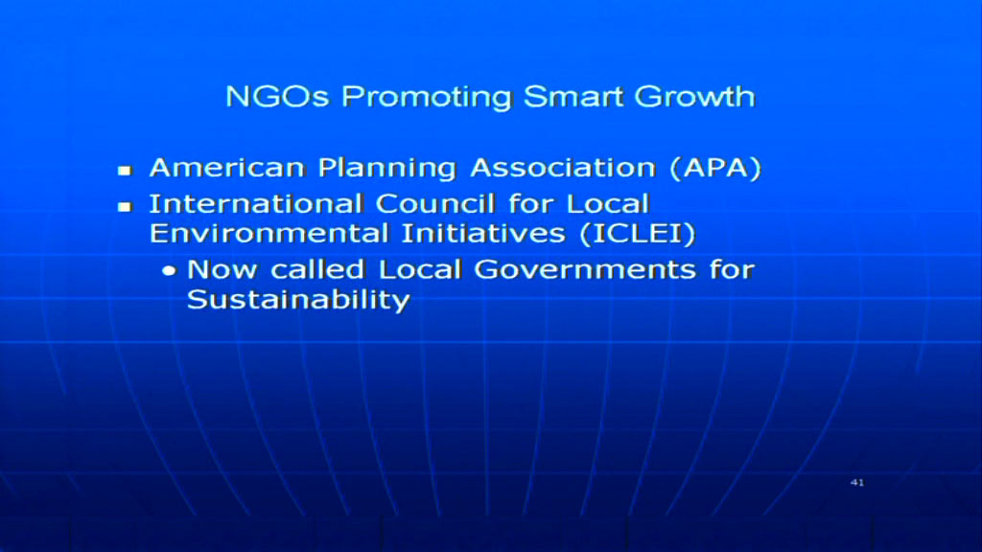
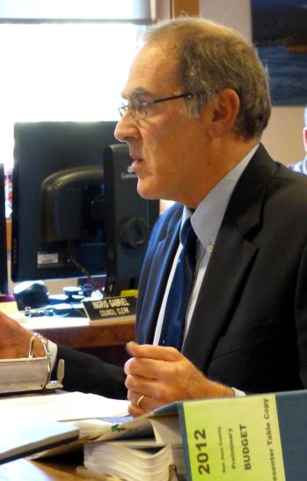
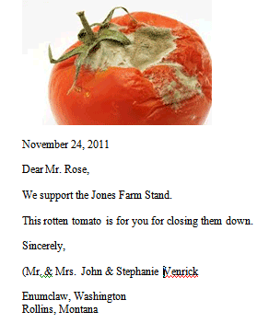

The Jones Farm taking - lopez island san juan county washington
This is only one of thousands of takings daily in America - Link here for the rest of the stories.
San Juan County forces Jones Farm-stand to close.
After two and a half years
of operation, the San Juan County CD&P has determined that we are operating our farm-stand “without the benefit of a permit”. This does not relate to our ongoing dispute with the county about the appropriate placement and operation of farm-stands on rural lands. That is a use, issue, and is still not resolved. Our current sin,
it appears, is to operate in innocence of commercial building codes. According
to Chris Laws and John Geniuch, enforcement officer and building official, respectively, we are not exempt from commercial building code requirements, as we had believed up to this point and as previous planning department officials had informed us. Our farm-stand is roughly 200 square feet, self-service, and sells a variety of frozen island
grow meats, frozen local seafoods, and fresh live Lopez Island Shellfish. This 200 square foot building is apparently required to satisfy all the legal requirements of a full sized grocery store, restaurant,
or any other commercial enterprise. We have been informed that we face prosecution if the issue is not “addressed” within 15 days of our notice. San Juan County appears from preliminary research to be the only Washington county where commercial building codes are enforced on farm-stands.
Compliance would cost us tens of thousands of dollars, as well as consuming vast amounts of time. However, neither Mr. Laws nor Mr. Geniuch is willing to tell us what exactly we need to do in order to comply before we submit a permit and commit to carrying out all required improvements. Our elected officials inform us that they have no capacity to protect us from these officials. We have neither the financial ability nor the desire to write a blank check to conform to pointless standards.
Jones Family Farms
Nick and Sara Jones
1934 Mud Bay Rd, Lopez, WA. 98261
360-468-0533 barlowbay@yahoo.com

Slide 44
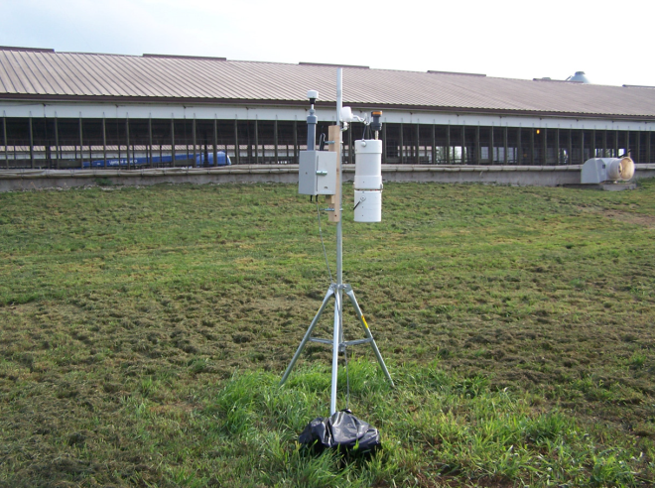
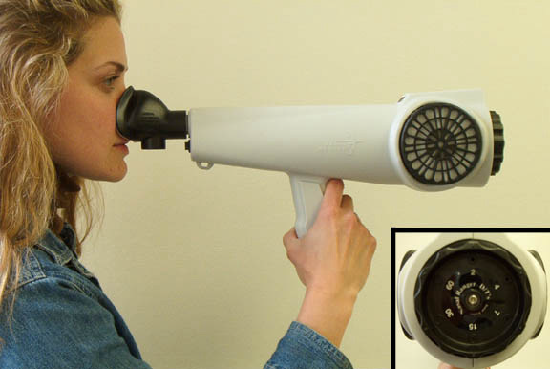

What is that smell hovering over pungent sound state of WA Inc.?
“At the moment you are most in awe of all there is about life that you don’t understand, you are closer to understanding it all than at any other time.”
Jane Wagner
Particle and NH³ samplers near pig barn
WA King County Muni. Corp. DDES , no advanced degrees in soft science/engineering specialty, uncredentialed and beyond biased employee sniffing for proper buffering
The Nasal Ranger® Field Olfactometer
King County WA Councilmember on the left & Olympia Representative on the right sniffing each others turf for the proper annual buffering parameters to levy upon the property owners. Note neither one can smell or see the difference anyway so UNESCO was brought in to design a machine to simulate the Best Available Buffers To Take from all property owners for their best good (BATS)
State sterilized pig farm
“The approach of coupling field-arrayed concentration measurements and inverse Gaussian modeling proved to be a valid and reasonable approach for modeling gas-phase ammonia emissions from the examined three-barn, deep-pit swine finishing facility (3,750 total animals). The derived NH³ emission rate of 17.22 ± 7.2 g/pig/day was slightly more than a factor of two greater than the referenced emission rate (Hoff et al., 2005), but within the range of statistical uncertainty. Due to the limitations discussed previously no statistical uncertainties can be calculated at this time.”
Source: Efficacy of Vegetative Environmental Buffers to Capture Emissions from Tunnel Ventilated Poultry Houses http://ncsu.edu/airworkshop/Posters-M.pdf
Assessor (left) sniffing at a dynamic dilution olfactometer. AC’SCENT Olfactometer photo courtesy of St. Croix Sensory, Inc.
BATS
DONATED
TO YOUR
LOCAL MUNI
BY
UNESCO

Slide 45
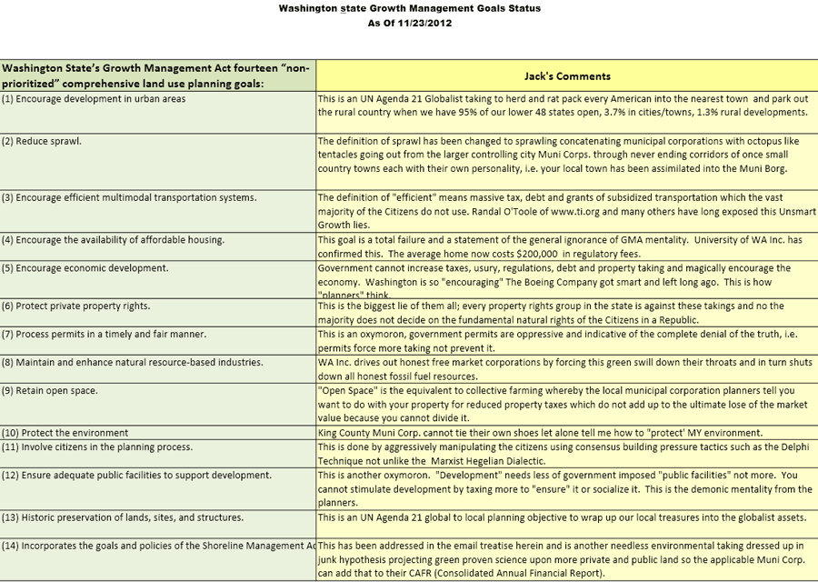
GMA Goals – bundled batches of buffers for you banishment by bloated barbarians
“The bird of paradise alights only upon the hand that does not grasp.”
John Berry

Slide 46

The Black Art of Planning – buffered, bloated and beguiling
“To know what we do not know is the beginning of wisdom”
Maha Sthavira Sangarakshita
Randal O'Toole is the Godfather of the “Antiplanner” and author of "The Vanishing Automobile and Other Urban Myths", 545 pages among other material he has published. Here is an extract from his website that says it all about planning.
"In the past thirty years, the Thoreau Institute has critiqued well over one hundred forest plans, park plans, transportation plans, and urban plans. We have consistently found that the plans are flawed, and when implemented they produce disastrous results.
The problem is with the idea of planning itself. Our new web log, The Antiplanner, promotes the repeal of federal and state planning laws and the closure of state and local planning departments. The blog will show why planning fails, document planning disasters, comment on planning news, and present the latest research on public lands, urban areas, and transportation.
Source of above material - http://ti.org/antiplanner
Tom DeWeese -- The American Planning Association and Its Faulty Handbook
Lies and Doublespeak of American Planning Association And How to Fight – Tom DeWeese
Regional planning brings regional governance – Henry Lamb
It should be obvious that the act of planning is done by the bottom of the labor pool directed by the bottom feeders, i.e. politicians, lawyers and NGO’s with more passion and bias than independent credible credentials in the areas they are planning, i.e. manipulating. This is a feel good business to make those taking property not liable for stealing private and public property debased on false beliefs and lies for power and profit.

Slide 47
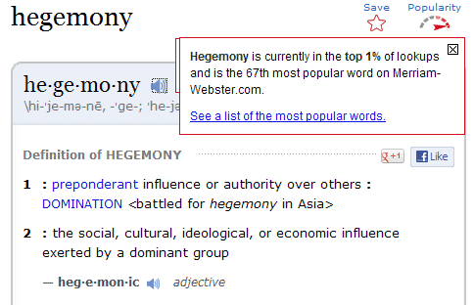
National Association of Counties – if it walks like a duck and quacks likes a Duck
It is the un again in your life
NACo Platform and Resolutions 2011-2012
  NACo 260 page document outlining agenda
  Key word search of this document uses many of the UN Agenda 21 buzz words, see below.
  NACO is debased on hidden takings of property & water without public debate and vote using back room political agendas to muster funding at any moral or fundamental laws of the land cost, i.e. acts, planning, taxes, policies, regulations, “safety”, “vision”, courts, “conservation”, cereal agencies.
Polygarchy– a term sometimes used to denote a government of many or several; a government where the sovereignty is shared by several persons; a collegiate or divided executive.
Black’s Law Dictionary 5th Edition
Word | Count | Word | Count
Act(s) | 1303 | Election(s) | 55
Plan/Plans/Planning | 638 | Law Enforcement | 51
Cost(s) | 443 | Military | 46
Tax(es) | 416 | Comply(ies)/Compliance | 41
Funding | 401 | Sustainable | 37
Policy(ies) | 391 | Homeland Security | 36
Grant(s) | 343 | Green | 34
EPA | 298 | Codes | 25
Water | 216 | Police | 22
Regulation(s) | 198 | International | 22
Energy | 172 | Deficit | 19
Safety | 147 | Judge(s) | 17
Vision(s) (6) | 130 | Global | 12
Court(s) | 124 | Ordinance(s) | 10
Report(s)/Reporting | 124 | Treaty(ies) | 10
Revenue | 117 | Penalty(ies) | 8
Security | 113 | United Nations | 8
Budget(s) | 87 | Smart Growth | 7
Conservation | 80 | Attorney | 7
Assessed | 71 | Property Right(s) | 7
Agency | 66 | Alternative Energy | 4
Land Use | 58 | Global Warming | 2
Election(s) | 55 | Light Rail | 2
Get your County out of National Association of Counties – they are lock stepping to the global to local direction whether they admit it or not, e.g. Montana MACo denies it.
NACo is involved with sustainable development
NACo Affiliates – I count 25 other national and international interlocking public/NGO self serving groups
53 State Associations connected with NACo
6 Other Affiliated Associations – you may not be surprised
Link here to understand the agenda behind the word “vision” used 130 times in the NACo Platform and Resolutions 2011-12 planning document.

Slide 48
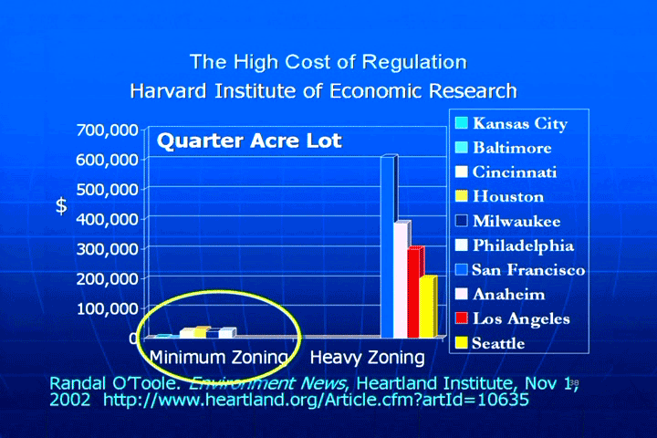
The High Cost of arrogance and ignorance – how planners baffle social, environmental, and financial buffers
"To pretend to know when you do not know is disease."
Lao-Tzu
The ruling classes including our current form of democracy have no independent unbiased scientific or engineering skills. They rule from the most debased professions on this planet, i.e. politics, planning, law and banking.
The political, legal, banking and planning ruling class never empowers the individual sovereign state Citizen because they much prefer to empower themselves to keep all property and small business owners powerless. Few know the difference.
Do you want fancy urban and rural areas with very "pristine" shorelines? The good news is you can have them.
We have a "great system" worked out to take anything you need for the common good of all. The bad news is the price you pay from this package of lies will cost you the sanctuary of your home(s) and property and ruin enough of your life to force you to take that too.
Spain is waking up a little bit after foreclosed property owners are committing suicide - http://www.thomhartmann.com/blog/2012/11/spain-has-had-enough-bankster-assisted-suicide
"When someone wants something you have, you are made the enemy, so they can justify taking it."
Source Unknown

Slide 49
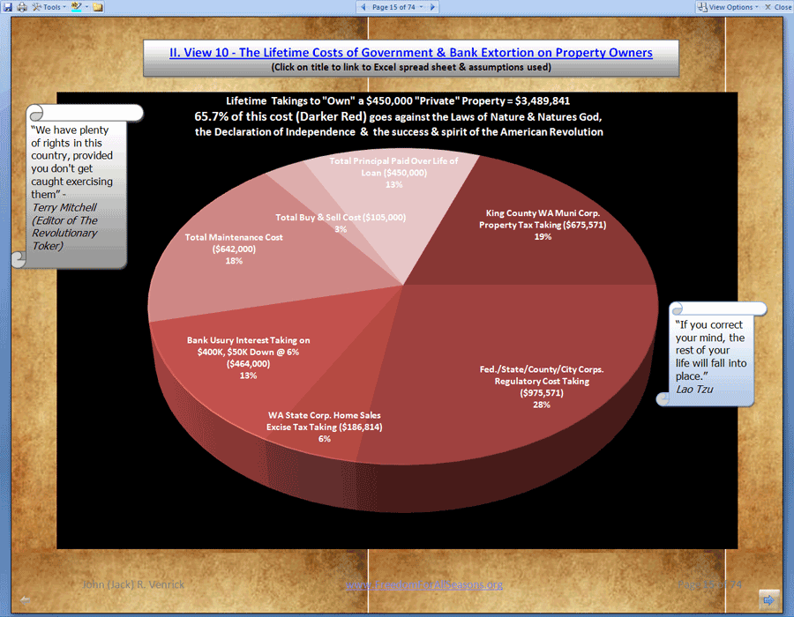
The High Cost of arrogance and ignorance, e.g. social, environmental, financial planning (Continued)
  Here's the price paid by home owners for extremism .
  For a $450,000 house and property you will pay $3,489,841 for the rest of your life. 65.7% of this cost is needless, fraudulent and goes against all the highest fundamental laws of the land. When you put a gun to a property owners head, you have just shot your children or your grandchildren in the head and uncountable millions who will have their homes foreclosed, forced into bankruptcy, divorce, plus millions more forced to go back to their parents home, if they are lucky enough to have parents and parents who are still alive who have a home to take them. A neighbor have been forced to take in several generations just to keep the family alive. Another one of my neighbors has left because the King County Municipal Corporations property taxes were a third of his SS income; he went to Idaho and does not pay state or federal income tax because he is under the minimum and pays only a fraction of the property tax. Three other neighbors are planning to leave, including us. That makes 4 families out of 10. Two more are gone and renting out their homes because they cannot stand it here. That makes 6 out of 10 that I know of on this old 65 acre diary farm subdivided in early 1970’s.

Slide 50
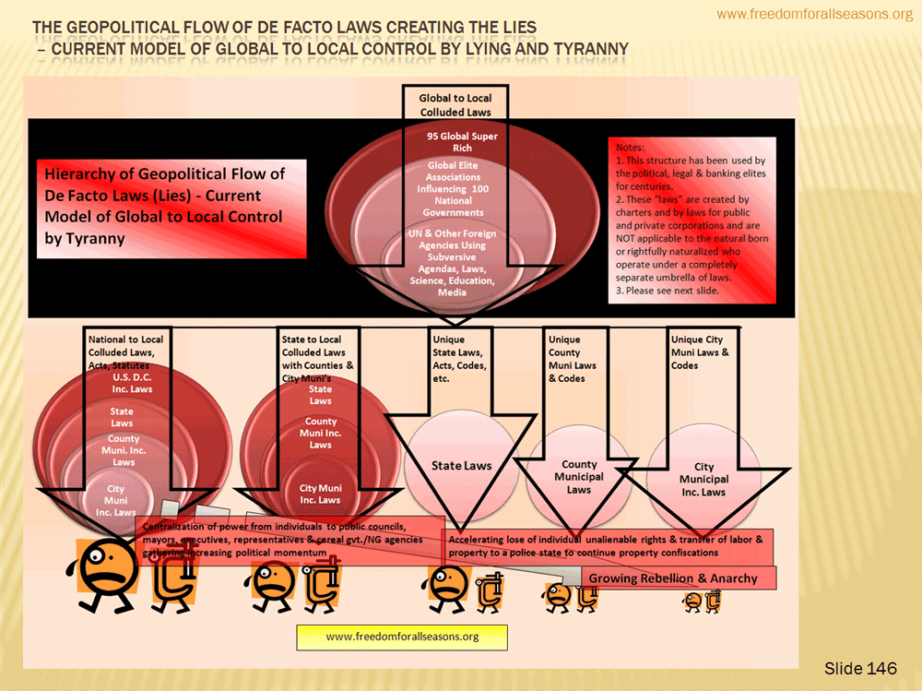
Political Defecation vs. Human Waste – how the state and its municipal corporations cook the books. (Continued)

Slide 51
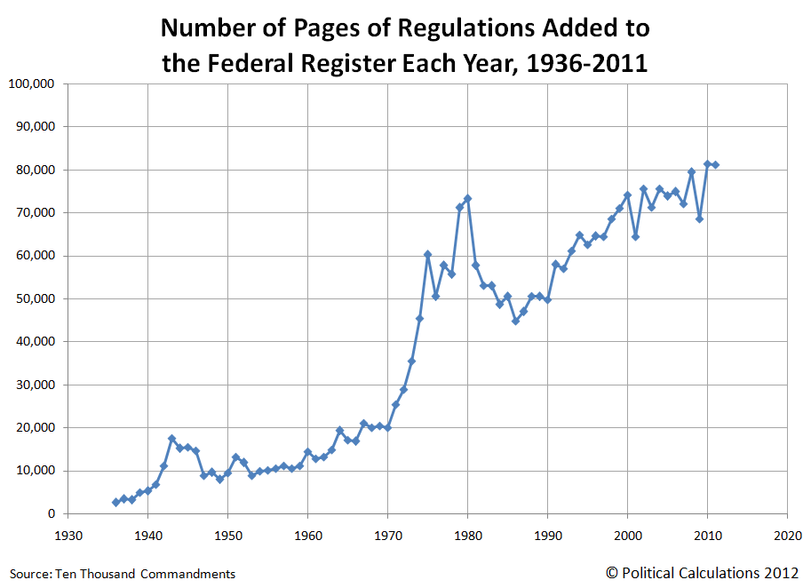
Political Defecation vs. Human Waste – how the state and its municipal corporations cook the books. (Continued)
“The Buddha and all his successors warn us against intellectual structures that confine us to an artificial environment, and against concepts that smear over the living fact of things in themselves.”
Robert Aitken
Buffer thinking uses emotion, fear, false flag deception, exaggeration, lies, bipolar decisions, monopolies, manipulation of public opinion, rejection of free choice, kangaroo regional and municipal councils, courts and administrative offices to divide and conquer. This bundle of emotions continually overlays free and sovereign state Citizens with layers of lies. Buffer types have backed themselves into a corner of self preservation at any cost. They fear "chaos of free choice" with a passion. This mentality would chose death before they change. Buffer public policy is debased on unproven hypothesis not scientifically rigid testing yielding highly confident results with very low error by independent researchers. Buffer science is political science which is no science at all.
Forced compliance never works. This ideology creates a bow wave of never ending "I know what's best for your property" which explodes into a standing army ultimately collapsing into civil war. Change is brought about through respect of the fundamental charters and actions of our land. Wars are all about forcing brinkmanship upon your neighbors. Forced compliance begets more force. Force is required for negative behavior of addiction which never has enough. A true and honest free limited Republic cannot force itself into the life or property of a natural born sovereign state Citizen.
The Puget Sound Growth Management Board, http://www.psrc.org/about/boards/gmpb is a fixed agenda council with the exception of one man, Robert Benze. This group, for the overwhelming majority, is a board of plutocrats representing the global to local agenda to continue the rule of municipal power (home rule) with token symbolism to make the public feel good. The proper make up of this board should be that it did not exist at all. This board has not been given power or jurisdiction or has been rightfully formed. They are formed from the inside out of the monarchy to transfer power and land from the rightful sovereign state Citizens to the applicable state municipal corporations. It is the appearance of law but is a lie in disguise, prima facie, de facto law.
Source http://finance.townhall.com/columnists/politicalcalculations/2012/07/29/the_regulation_of_the_american_people/page/full/

Slide 52
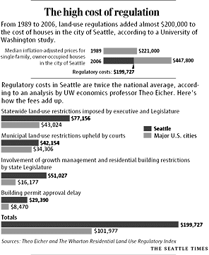
Political Defecation vs. Human Waste – how the state and its municipal corporations cook the books. (Continued)
“When you are deluded and full of doubt, even a thousand books of scripture are not enough. When you have realized understanding, even one word is too much.”
Fen-Yang
San Juan Citizens Alliance for Property Rights filed legal action in San Juan Superior Court against the County of San Juan alleging both violations of WA Open Public Meetings Act and violations of the WA GMA.
  The suit questions how the Council as a whole has determined to use BAS re. CAO (Critical Area Ordinance)
  The suit questions the County’s failure to qualify its ‘expert,’ Dr. Paul Adamus who has admitted he is not a statistician where buffer determination is all about statistical analysis.
  The suit says the County has ignored other professional opinion, e.g. of a qualified expert Dr. Tim Verslcycke of Gradient Corp and Woods Hole Oceanographic Institute and his report dated 9/5/2012 which criticized the CAO “Best Available Science” while instead relying on Dr. Adamus opinions, contrary to WAC 365-195-905(4).”
  San Juan County relies on inappropriate data and incorrect interpretations by Dr. Adamus and County staff for the purpose of its agenda to push CAO via flawed BAS requirements of GMA.
  The suit states the “Committee has met regularly approximately one hundred times in private and has performed substantive public business, yet did not fulfill the public notice and publication requirements nor the public access requirements of the OPMA.”
    http://www.islandguardian.com/archives/00004585.html
    http://www.whatcomexcavator.org/3/post/2012/10/capr-files-legal-action-in-san-juan-superior-court.html

Slide 53
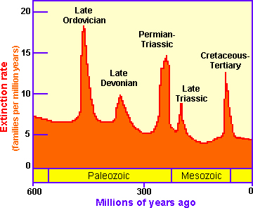
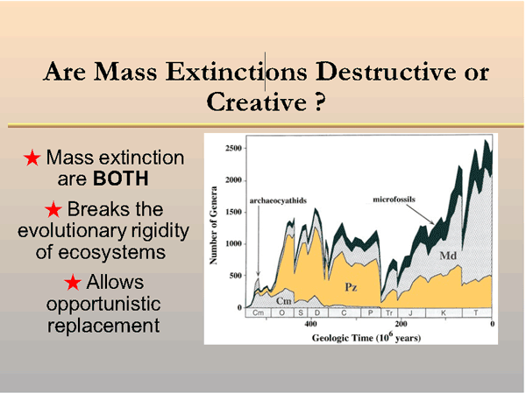
Buffering The truth about endangered species and extinction To Take more Buffers
“Of that which you see, believe only a little. Of that which you are told, nothing.”
Spanish Proverb
  “Mass extinction is creative NOT destructive
  Mass extinction occur at regular spacing in time, i.e. not random
  1900 marine animal families living today versus ZERO, 600 million years ago
  Virtually all organisms eventually become extinct
  Population size of taxa (species) decline over time; most genera and species disappear
  Continued coming and going occurs in the background as new taxa originate
  When large percentage of known taxa all undergo extinction during one interval of time, then mass extinction
  Results from severe global physical perturbation
  Breaks the evolutionary rigidity of ecosystems
  Allows opportunistic replacement
  Wide geographically ranging taxa resist extinction better, local events don't impact the population
  Van Valen's survivorship curve showed majority of taxa had short duration's, fewer and fewer with longer duration's
  Chance of extinction is independent of how long it has survived
  Short lived and long lived taxa have the same probability of experiencing extinction”
  http://www.freedomforallseasons.org/EndangeredSpeciesTakings/Mass%20Extinction%20The%20Big%20Ones.pdf
  99.9% of all species have gone extinct, what's the point of spending billions to "delay" what Mother Nature is doing
  8 Years of research why EPA/ESA is creating myth
Public planning is a snowball of deception rolling across our free land and forced down our throats strangling freedom and liberty to death.
There is no true and honest scientific or economic fully tested hypothesis with conclusive highly confident repeatable research by unbiased independent researchers that any of these planning paradigms such as buffers, growth management, shoreline management, critical areas rest on the truth.
Man caused species collapse, man caused global warming, man caused "alternative energy" are weak hypothesis at best and lies at the worst which have long been proven not true by many credible independent individuals and groups. This political "science" has cost American taxpayers billions unnecessarily by the targeted destruction of innocent lives, homes, land and wages while transferring vast wealth and resources into the pockets of the elite global to local mainstream parties, banks, media, BAR associations, elected and unelected councils and administrators.

Slide 54

Buffering for the new spotted owl – sage grouse, a.k.a. sage chicken how the environmentalist play chicken with your property
“We have also discovered the studies relied upon by the government that projected future oil and gas production as the destroyer of grouse habitat were based on studies not available to the public and, therefore, not fully peer reviewed at the time the {U.S. Forest} Service made its finding. Several cited studies were clearly biased, such as the one prepared by The Nature Conservancy in Wyoming, hardly an objective scientific perspective.
“One of the restrictions creates an eight mile buffer zone around breeding sites preventing all human disturbances such as grazing, fence building, roads, power lines, pipelines, development, oil and gas production and dozens of other beneficial uses.
Another restriction creates an arbitrarily determined three percent “disturbance cap,” where no more than three percent of the land within a priority habitat can show human disturbance.
Together, the eight-mile buffer and three percent cap means 97 percent of the priority habitat for the greater sage grouse in the 11 Western states will be off limits to any human activity.”
http://www.freedomforallseasons.org/FreedomFromEndangeredSpeciesMythomania.asp
“Little guys first grouse plus a bonus dove.”
http://www.fishingbuddy.com/the_grouse_and_partridge_hunting_category/?app_task=Photos&app_p=2
1. WYOMING GROUPS WIN: NO RESTRICTIONS OVER SAGE GROUSE
2. Western States Fight The New Spotted Owl Takings, The Sage Grouse/Chicken Takings of property.

Slide 55
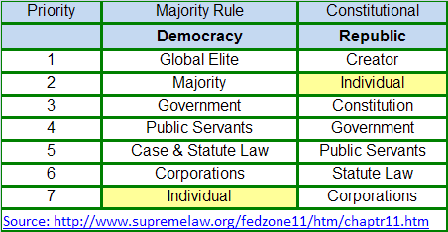
The “Scientific” method
I am not a fan of Wikipedia however, they have done a decent job of over viewing the scientific method, extracts below from
https://en.wikipedia.org/wiki/Scientific_method
“The scientific method (or simply scientific method) is a body of techniques for investigating phenomena, acquiring new knowledge, or correcting and integrating previous knowledge.
Scientific researchers propose hypotheses as explanations of phenomena, and design experimental studies to test these hypotheses via predictions which can be derived from them. These steps must be repeatable, to guard against mistake or confusion in any particular experimenter. Theories that encompass wider domains of inquiry may bind many independently derived hypotheses together in a coherent, supportive structure. Theories, in turn, may help form new hypotheses or place groups of hypotheses into context.
Formulate a question
Hypothesis
Prediction
Prediction
Analysis
Replication
External review
Data recording and sharing”
And the message of this slide is:
Even the most independent repeatable research with highly confident results and low errors is not perfect. Mother Nature penalizes perfection and embraces diversity including diversity of thought and opinions. Inanimate objects such as ball bearings are ideal for statistical predictions as well as gross human physical measurements , e.g. height, weight, IQ.
The more complex and natural the system is, the more unpredictable it becomes.
Only man is arrogant enough to pontificate irrefutable research findings, then force it into legislation, regulation, codification, administration followed by centuries of judication and misery, topped off by war just to make it more politically correct.
There is always a “faster gun” in training to bring even “true and honest” science down let alone poorly conceived and highly disputed conclusions by credible independent scientists and engineers and the victims.
Even if all of a state’s Representatives, Senators and all public and private scientists agreed on a public policy, they could never force a rightful Republic state Citizen to drink the “truth” or the “swill.
A “Majority” Rule Democracy is a “mobacracy” centrally controlled and planned by the global to local elite.
A True and Honest free limited Republic “controls” by INDIVIDUAL free choice, i.e. anti-control & anti-planning.
The Half Life of Facts - More reasons “facts” lie http://www.wired.com/wiredscience/2012/09/introducing-the-half-life-of-facts/
The Scientific Method Song
https://www.youtube.com/watch?v=eA86dYxrg4Q

Slide 56

How nature heals itself
“Tolerance and patience should not be read as signs of weakness. They are signs of strength.”
The Dalai Lama
May be a few second delay for link to see your cursor.
Letting Nature Heal Itself - “The ecosystems destroyed by the deadly earthquake in May formed over the course of millennia. But their natural recovery will take only decades, writes ecologist Jiang Gaoming.”
Living on Earth: Nature Healing Itself - “CURWOOD: As we all learned in science class, to every action there is an equal and opposite reaction. Nowhere is that more evident than in what we like to think of as technological progress. New technology often leads to unanticipated ecological damage, which leads to a seemingly endless effort to repair that damage. But as Living on Earth commentator Ruth Page notes, in their search for solutions scientists are learning that nature may already have the answers.”
Natural Healing - “In 1989, the petroleum tanker Exxon Valdez struck Bligh Reef off the coast of Prince William Sound in Alaska and poured a minimum of 11 million gallons of oil into the water—enough to fill 125 Olympic-sized swimming pools. Senior scientist at NOAA, Stanley Rice of Juno, Alaska, studies the long-term effects of the spill and the resulting oil-related issues in Prince William Sound. Rice has worked with the spill since day 3 and, 20 years later, he is seeing major progress. “I never want to give the impression that we had this devastating oil spill in 1989 and it's still devastating,” he said. “We have pockets of a few species where lingering oil hurts their survival, but in terms of looking at the Sound in its entirety […] it's done a lot of recovery in 20 years.”
Natural disasters NOT man made natural disasters are the overwhelming problem. Man can learn to change his ways by free choice and Nature then is quite capable of healing herself
“Healing only comes from that which leads the patient beyond himself and beyond his entanglement with ego.”
C. G. Jung

Slide 57
Eminent Domain is a lie
Larceny. In criminal law. The wrongful and fraudulent taking and carrying away by one person of the mere personal goods of another from any place, with a felonious intent to convert them to his (the taker's) use, and make them his property, without the consent of the owner. Blacks Law Dictionary 1910, 2nd Edition
Article II Eminent Domain - THE LIE Click on above title for more on state of WA
Section 3. State of Washington Original 1878 Constitution
Section 3. is MISSING in the 1889 WA Constitution, i.e. it was taken out of the 1878 version by the politicians and their lawyers and bankers. "The people of the state, in their right of sovereignty, are declared to possess the ultimate property in and to all lands within the jurisdiction of the state, and all lands, the title to which shall fail from a defect of heirs, shall revert or escheat to the state. ”
Jack's comments: Eminent domain replaced the Law of Mortmain of England. Eminent domain destroys your allodial rights and goes against the Laws of Nature and Nature's God, the Declaration of Independence and the success and intent of the American Revolution. This is one of many conflicts written into the US and state constitutions for profit and power going against the higher laws of the land. Article V of the U.S. Constitution Bill of Rights "nor shall property be taken for public use without just compensation" does NOT infer private property will be taken by force NOR does it infer private property can be taken and then it is only applicable to U.S. territories. Once again, we have been duped by the politicians, lawyers and bankers.
The Law of Mortmain is Old French (morte meyn), dead-hand. http://www.newadvent.org/cathen/10579a.htm
2011-06-12 Mortmain Dead Hand CATHOLIC ENCYCLOPEDIA
The Beginning Of The Lie
THE TRUTH
Blacks Law Dictionary Revised th Edition 2003 ALLODIAL. Free; not holden of any lord or superior; owned without obligation of vassalage or http://www.freedomforallseasons.org/FreedomToOwnLandWithAllodialRights.dwt.asp fealty; the opposite of feudal... ALLODIUM. Land held absolutely in one's own right, and not of any lord or superior; land not subject to feudal duties or burdens. An estate held by absolute ownership, without recognizing any superior to whom any duty is due on account thereof…
1883: Butchers' Union Co. v. Crescent City Co., 111 U.S. 746. This decision defines labor as property, and the most sacred kind of property. "Among these unalienable rights, as proclaimed in the Declaration of Independence is the right of men to pursue their happiness, by which is meant, the right any lawful business or vocation, in any manner not inconsistent with the equal rights of others, which may increase their prosperity or develop their faculties, so as to give them their highest enjoyment...It has been well said that, THE PROPERTY WHICH EVERY MAN HAS IS HIS OWN LABOR, AS IT IS THE ORIGINAL FOUNDATION OF ALL OTHER PROPERTY SO IT IS THE MOST SACRED AND INVIOLABLE...”
Inviolability - Blacks Law Dictionary 1910 2nd Edition The attribute of being secured against violation. The persons of ambassadors are inviolable.

Slide 58

The nature of natural
"I was standing on the highest mountain of them all, and round about beneath me was the whole hoop of the world. And while I stood there I saw more than I can tell and I understood more than I saw; for I was seeing in a sacred manner the shapes of all things in the spirit, and the shape of all shapes as they must live together like one being."
Black Elk described his Great Vision on Okawita Paha (Harney Peak) (See picture below)
A true and honest free Republic is in a continual expansive state of sharing resources NOT isolating , limiting and labeling them by environmental de facto tyranny from their true owners.
Nature is a garden not a buffered wilderness in a perpetual state of political environmental quarantine for the benefit of the global to local central planners and NGO’s profiting in power and revenue from the taking.
The American rightful state Citizen cannot be forced out of his natural state to live off his/her land and water or forced to comply by threatening his birthrights.
All public resources must be shared as in multiple use in a true and honest Republic.
Free born state Citizens have rightful demand to homesteading, gardening, hunting, pasturing and recreation of all public resources.
Governments, political subdivisions, municipal corporations and the public servants have no rights and are not sovereign during working hours.
American resources are God given and abundant requiring prudent care not global to local criminal extremism.
Man’s ability to willfully and unwillfully neglect stewardship of his resources does not submit him to deprivation to his rights of freedom, liberty and full use of his natural resources most especially for food, water and shelter.
Man’s ability to change his environment pales to Mother Nature’s natural cycles over epochs both in Her power to destroy and to heal.
Man and Mother Nature heal each other through acts of direct love NOT extremism debased on highly questionable “science”, i.e. junk agenda science.
Credit to the Judy Larson at http://www.capturedakota.com/users/justimaginebyjudy

Slide 59

The nature of natural - Part 2 of 4
“In order to swim one takes off all one’s clothes – in order to aspire to the truth one must undress in a far more inward sense, divest oneself of all one’s inward clothes, of thoughts, conceptions, selfishness, etc., before one is sufficiently naked.”
Soren Kierkegaard
The Natural state is extreme and unlimited. She is 4.5 billion years old on earth. Man’s life does not even register on Her scale of time. Our civilization is one of some 4 which has come and gone by natural disasters and self destruction by war.
Democracies manipulate the truth to control the masses to broker the earth for selfish power and profit.
True and honest free limited Republics live in love and tolerance and free choice for each individual Citizen, no exceptions.
A true and honest free Republic open their arms to the most filthy dirt poor as well as the most arrogant obsessive compulsive environmental extremist. Neither one is taken advantage of nor is force ever used.
America is founded on the Laws of Nature and Nature’s God, i.e. the highest laws of the land are natural laws, then the Declaration of Independence then the spirit and success of the first American Revolution.
Extreme natural and extreme unnatural disasters are treated the same and embraced in love not force.
All American private property is allodial and all public property is multiple use.
When nature cries so do the natural born, i.e. we do not need self righteous arrogance beating the jungle drums and the property owners off their livelihood.
American natural born and rightfully naturalized state Citizens cannot be forced to comply to any man made codes, ordinances, legislation, laws or administrative orders.
Man protects nature by acts of kindness to all life not by selective acts of violence to some.
Plant life grows faster when it is stressed
Credit to Dr. Willie Soon via:
http://www.goodneighborlaw.com/
http://www.landandwaterusa.com/

Slide 60

The nature of natural – part 3 of 4
“The thing about Zen is that it pushes contradictions to their ultimate limit where one has to choose between madness and innocence.”
Thomas Merton
A true and honest free limited Republic does not imprison its Citizens or its resources based on politically contrived “public policy”.
Good and bad intent upon our land and water become blurred by the use of force and deception.
So called public policy do not restore nature, they ultimately destroy nature and the natural born Citizens.
The end intent of “public policy” does not justify the means.

Slide 61

The nature of natural – part 4 of 4
“Life is a maze in which we take the wrong turn before we have learned to walk.”
Cyril Connolly
Political manipulation of nature kills creativity and assures failure due to collateral downstream problems beyond human comprehension impacting the generations proceeding.
Many false beliefs which have taken on a life of their own can no longer be supported in the mass consciousness.
The nature of these mass takings of property are debased on a false structure of political, “scientific”, financial and monetary negative rewards which have long run its course.
Elite groups of very passionate people have created their own reality through their own belief system and successfully projected it globally to locally like the popcorn effect.
The victims of these groups have a very different view supported by real science reality who cannot be obligated or forced to comply in a true and honest limited free Republic.
“Reality” is manipulated through various lens of perceptions, e.g. politics, religion, science, law, etc.
Manipulated data including holding back the big picture or creating a biased big picture through dogma boils down to intolerance for others unalienable rights and rightful credible dissenting “science.
Intolerance, fear and highly judgmental agendas are hallmarks of blind belief systems.
So called buffers, sensitive areas ordinances, critical area ordinances, Shoreline Management Acts, Growth Management Acts are environmental and social feasibility studies AT BEST which should never have been allowed into real life conditions.

Slide 62

Watersheds - muni buffers by another label – part 1 of 2
Hypocritically taking rural resources never allowed by private citizens, dredging, rerouting water, pumping, damming rivers, constant construction, playing with the fish, denying public access while the urban Muni Corps. decry rural septic and well systems
The Arrogant & Hypocritical Public Municipal Corporations
Walsh Lake area (King County Municipal Corporation, WA Inc. ) is just a small part of the so called Cedar River Watershed which the Seattle Municipal Corporation has taken 90,000 acres (141 sections of my rural land) and then restricts access to the public. It’s a forest to us mislabeled a “watershed” to make it easier to take the land away completely.
The next section of land north is the Alpine Lakes Wilderness, closed to all motorized use. Public lands must be multiple use NOT special use.
Then the Muni’s brag how hard they work to keep the water clean & fish flowing never telling you they didn’t have to do this at all or did you ask.
Now you know how and why only some 9 city municipal corporations have confiscated our ”pristine wilderness” by just changing the label to {insert name of city corporation here} “watershed”.
What is wrong with using their own rivers flowing into their cities and getting out of our rural mountains, our rural fish and our rural way of life.
Notice the adjacent toxic Landsburg landfill.
One gorge over from Cedar River the Tacoma WA Inc Muni. Corp. is doing the same thing, tapping into our rural water via dams, treatment plants and commercial wells while restricting access to it, robbing the property owners to do it and then buffering the mess they made all while they live on a major sea port with rivers flowing into the port.
Municipal Ownership Movement:
Link here for a relatively good article on how the infrastructure in Seattle WA and the Puget Sound area has transitioned from private to largely public. It is shades of the AT&T breakup. I like to think of this private vs. public paradigm as “wherever we go there we are”, i.e. sharking out the little guy for profit and power, vis-à-vis, stealing lollipops.

Slide 63

Watersheds - muni buffers by another label – part 1 of 2
I don’t have to tell anyone with an open mind that this municipal and state madness is inbred with a level of arrogance, hypocrisy and myopic blindness. Municipal monopolies take both your wages and your life and then lie to you that it is for some public green good.
Book here for your green deity cultural heritage tours of these takings.
All while they flush their waste into Puget Sound, forcing us into eusocial high density ghettos, turning our rural country into rails to trails and roundabouts for fish and humans, setting their wilderness off limits to public access and their watersheds off limits to public access, buffers around every creek, lake and sound and ocean.
It is time to privatize the municipal monopoly monarchies, they are a blight to our natural sight.
The Municipal Mafia can start with drilling for their own water in their own sand boxes and using desalination for coastal cities especially for the ones dumping their sewage into the sound and the sea.
“Low cost desalination, call off the hunt, we are there”
This is just one story of one municipal corporation which has rerouted its rivers and sewage into the Mississippi.
“In 2002 it was found that a portion of the Outlet Channel between Morse Lake and the Masonry Pool had filled in with sediment resulting in insufficient depth to convey the 240 million gallons per day (mgd). The channel was dredged and the discharge dike rebuilt and was raised to elevation 1538 feet, which is now the lake elevation below of which pumping is required. Subsequently, the Outlet Channel has again filled with sediment. Therefore, the water stored between elevations 1532 and 1538 feet is part of the “normal” water supply available to use without declaring a water emergency, activating the water shortage contingency plan, or initiating demand curtailment by customers. However, this storage volume cannot be used without pumping under the existing conditions.”

Slide 64


Public works – “stupid is as stupid does”
So called public works infrastructure would NOT have been born if the madness of the municipal monopoly could not put a gun to each property owners head and say your water and sewer or your life. THIS IS CLEARLY A THREAT.
Communities ORIGINALLY came together to share sewer and water systems as a private FREE CHOICE COOPERATIVE NOT as a forced tax and property taking eco CON game.
A true and honest Free Limited Republic cannot force the natural born state sovereign and free Citizens into legal fiction political subdivision prison camps for the common good even if it means “for their safety and health” using the “Best Available Science”. This is Happy Talk of collectivism.
“Natural buffers”, “public infrastructure”, “wetlands”, “dry lands”, “man caused global warming”, “alternative energy”, eminent domain, usury, regulations and taxes are all con games the political crooks are using to game the system to broker what is rightfully free choice through local private enterprise controlled by free market and competition and a level playing field.
The only role of a limited free Republic is to force the playing field level NOT to mount the game board.
The government corporations and their constitutional children, the private and public corporations, are the most toxic chemical in the mix, not the individual rightful sovereign natural born Citizen.
Government private and public corporations are being used to create a massive buffer of ”public works” around the sovereign free Citizens to imprison them by manipulated labels. The labels “Buffers”, Watersheds”, “Wilderness”, “Zoning”, “Critical Areas”, “Sensitive Areas”, “Shoreline Management”, “Growth Management”, “endangered species” are the fait accompli to grease the takings. These takings are debased on gross misrepresentations dressed up as green trappings.
City of Seattle Municipal Corporation floods out its Citizens who then have to sue for damages, and they won.
I hope its clear now, how municipal monopolies are ravaging our rural country and mountains for their water, flooding out the local Citizens all while they scream green to keep everything natural except themselves.
Force privatization of the municipal monarchy into private user/owner cooperatives and this tyranny will melt like ice in the sun.
Currently the public infrastructure like public power companies are not allowed by the municipal corporations to privatize or reorganize to cooperatives because the greedy municipal want the best of both worlds, the profits and the taxes. Furthermore the public power companies are not allowed to show profit because they are forced to share any with the municipal. It is a parasitic relationship.
The Real Toxic Buffer To Fight
The new green age label of Public Works has mutated to mean the right to take any private and public property which can be labeled buffer, wetland, park, forest, wilderness, watershed, critical area, ad nausea and bundle it into pretty green wrap then gifting it over to the globalist, i.e. One World Government, a.k.a. UN. Please click on the above map and educate yourself on this massive taking.

Slide 65



The Green Toxic byproducts
“bufferholics“ never speak of
“Life is like a game of cards. The hand that is dealt you represents determinism; the way you play it is free will.”
Jawaharlal Nehru
Environmental extremism translates to fraudulent debt and usury where all property taking originates from. That is to say the central Banksters who created this mass hypnosis of involuntary confinement (buffers, et al green) which is a hostile act going against LONGANG, Declaration of Independence and the spirit of the first American Revolution.
Eliminate debt, usury, forced taxes and this house of Buffers is swept into the dark ages where it belongs.
Americans can tie their own shoes and take care of their own allodial land without UNnatural global to local buffer swill poured down their throats.
Message to all Green Extreme from American Property Owners : Get out of our lives, off our private and public property and go get a real job that produces something of marketable value.

Slide 66

Bloated beguiling buffer makers

Slide 67

Voluntary Private Standards organizations – a rightful replacement for Muni codes, ordinances, regulations, taxes, fees, penalties, tyranny and buffers
“To fall into habit is to cease to be.”
Miguel De Unamuno
The free market standards organizations are largely private associations of professions and trades who have established mutually agreeable tolerances, materials and processes for their applicable engineering, science and trades.
The standards industry is international, national, regional and local, there are thousands of companies and associations who have developed their own standards which has led to a growing codification of respectful technical specifications.
Standards are voluntary and largely independently established in a community of relative integrity compared to the political forced swill and agenda.
Standards are created from largely independent research, lessons learned through decades of trial and error with a level of respect of those involved in the research, manufacturing , government, industry to the end users.
The author of this presentation devoted the last few years of his career at The Boeing Company in a commercial airplane engineering standards organization. It was a relatively small group for Boeing. However, everyone knew who we were and most of all we never released a new standard or revised an existing standard or automated the standard system without a long line of approvals by the rightful organizational users. I stumbled into a great opportunity to develop a standard system for some 30,000 engineering structural profile cross section designs which had accumulated over Boeing some 80+ years including on napkins. Standards are engineers answers to monopolies.
Standards have long been moving from paper to the digital world to further automate the CAD/CAM design and manufacturing process in the private sector’s never ending struggle to reduce costs and stay alive for their employees and investors.
Voluntary standards industry freely umbrella the world and are used in every product and service you can imagine, they are the free market glue holding free enterprise technology together.
What holds the free market together can easily replace the predatory government cereal agency functions.
Environmental, monetary, social, educational and all governmental agencies can be privatized and offered back as free choice for those few functions which have true and honest value in a free market.
Graphed From This WSJ Data Source: http://online.wsj.com/article/SB10001424052970203518404577094861497383678.html#project%3DREGS121520111215%26articleTabs%3Dinteractive

Slide 68

Private Coops Must replace municipal corporation co-opting
In a true and honest free limited Republic there is no difference between a private and public corporation regarding authority over sovereign Citizens.
Neither have any power, authority or jurisdiction to threaten a sovereign free born state Citizen.
The constitutions of a true and honest free limited Republic were to prevent exactly what has happen to us now furthermore, this tyranny was designed in .
In a true and honest free limited Republic cooperatives serve the communities and share their profits and losses without taxation, e.g. Flathead Electric Cooperative, Kalispell, Montana.
The state constitutions gave birth to private and public corporations and political subdivisions. The state constitutions stand down to the higher fundamental and founding charters and acts of America, i.e. LONANG, Declaration of Independence and the spirit and success of the first American Revolution.
Private or public entities never received rightful authority or jurisdiction over the sovereign free state Citizens or their private or public land. This land is our land and it is unquestionably allodial which means inviolable, immutable, indisputable, unrestricted, unqualified and absolute as in no buffering allowed.
Your next question may be, how can we privatize and coop the global to local controlled public sector and keep our schools going?
Please see the next slide.

Slide 69

Bucks to buffers - how the game works – part 1 of 2
“In a dark time, the eye begins to see.”
Theodore Roethke
Critical History To Understand How The Game is Fixed
The Articles of Confederation still stand and never approved taxes and required unanimous approval of any changes , additions or new charters.
The so called U.S. Constitution was not unanimously approved having only received 9 states approval and some of them were by force with others forced in much later thru trade embargo, etc.
The British Monarchy infrastructure including property taxes was never thrown out (it should have been) with the rest of King George III feudal system after the Battle of Yorktown , the end of the 20 year revolution 10/19/ 1781.
Constitutions are charters to limit the Republic NOT the Citizens. The rightful Citizens are unlimited. The men who wrote these documents for the commonwealths and republics were generally merchants, lawyers and the well healed class of the time. Farmers and the common man were excluded. Consequently the tax taking of the monarchy via property taxes, et al was largely left in place.
After General Washington and the French Navy out gunned British General Cornwallis and his 7000 men and as the treaties were signed adding the remaining territories to the West, it became a new ball game. We were now a land of allodial rights and the INDIVIDUAL state CITIZEN is the new sovereign Kings and Queens.
Sovereign free Citizens in a free limited Republic with allodial rights CANNOT be taxed directly or indirectly including after death for any reasons including buffers taking. Buffers are a tax.
Summary of Part 1 and 2 Graphs
Currently 12 to 14% of Wages Pay 85 to 91% of Federal Taxes
Currently 1 % of Corporate Revenue Pay 9 to 15% of Federal Taxes
Individual Federal taxes can be replaced by a 12 to 14% tax on Corporate Revenue
Currently .17% of Corporate Revenue Pays State Taxes
Currently 5.18% of Individual Payroll (Wages) Pays State Taxes
Individual State taxes can be replaced by a 1.04% on Corporate Revenue
All taxes are ultimately paid by the consumer

Slide 70

Bucks to buffers - how the game works – part 1 of 2
“By ignorance the truth is known.”
Heinrich Suso
Taxing of the rightful sovereign and free state Citizens is NOT necessary nor is it legitimate. Taxing of humans is slavery and is not tolerated in a true and honest free limited Republic. This is how our belief systems have been gradually programmed over generations.
The sovereign Citizen creates a free limited Republic to serve him or her NOT visa-versa. The higher fundamental and founding charters and acts are the rightful proxy over the Republic and its constitutions. LONANG, Declaration of Independence and the Spirit and success of the first American Revolution are very clear in this regard.
The Republic then creates the private and public corporations to serve the people. The corporations act to employ the people and pay all the taxes. When the products or services provided by these corporation are sold, the people who purchase the goods voluntarily pay those taxes when they purchase as the corporations see fit to pass through and absorb and pay their shareholders.
The rightful state Citizens are sovereign and free with 70 some birth rights including allodial land rights. The citizen and their property cannot be touched, taken or buffered for any reason without exception. The new Kings and Queens rule and are NOT ruled by elite NGO’s or “represented” by anyone especially “minorities”, “majorities”, central planners, administrators or judiciary.
America is a limited Republic and each rightful Citizen rules as he or she see fits, i.e. by their free will. This is done by individual contracting NOT by sweeping buffer mania.
In this light, a rightful tax system in a true and honest free limited republic is a direct tax on corporations ONLY, NOT the Citizens. Otherwise the Citizens will be paying compounded taxes for everyone multiple times as we do now, the very definition of insanity.
Summary of Part 1 and 2 Graphs
Currently 12 to 14% of Wages Pay 85 to 91% of Federal Taxes
Currently 1 % of Corporate Revenue Pay 9 to 15% of Federal Taxes
Individual Federal taxes can be replaced by a 12 to 14% tax on Corporate Revenue
Currently .17% of Corporate Revenue Pays State Taxes
Currently 5.18% of Individual Payroll (Wages) Pays State Taxes
Individual State taxes can be replaced by a 1.04% on Corporate Revenue
All taxes are ultimately paid by the consumer

Slide 71

sovereignty of the american citizen - what it means
“Not one in a million feels the freedom to live what he inwardly feels he should live. He has come under the world opinion of himself, and this opinion is what he obeys, rather than the law of his own being. In this respect and to this degree he is living under an hypnotic spell. He lives under the delusion that he is a mere human being, living in a merely material world, and only hopes to escape it when he dies and goes to what he calls heaven. This is not the determination intended in the plan and purpose of life. Obedience to one’s inner nature, the expression of life as he instinctively feels it ought to be expressed, is the very foundation of the life which the masters reveal as the only true mode of living.”
The Life Of the Masters of The Far East, Vol. 4, page 198,
Baird T. Spalding
“Sovereignty itself is, of course, not subject to law, for it is the author and source of law…”
Yick Wo v. Hopkins
118 U.S. 356; 6 S. Ct. 1064 (1886)
May 10, 1886
The current system of government most especially the laws, are steeped in the old European feudalism threading to nobility, e.g. Kings, Queens, Nobleman and the priesthood of the church.
After the first American Revolution, this all changed, the rightful power and sovereignty was given to the individual American state Citizen to create a new free Republic.
The individual American state Citizen cannot be forced to trade naturally bestowed unalienable rights for political, financial, monetary and legal fiction agendas steeped in collusion and complicity using covert “emergencies”, treaties and war.
FreedomForAllSeasons
"No fiction can make a natural born subject." Milvaine v. Coxe's Lessee, 8 U.S. 598 (1808).
"The very highest duty of the States, when they entered into the Union under the Constitution, was to protect all persons within their boundaries in the enjoyment of these "unalienable rights with which they were endowed by their Creator.",
U.S. v. Cruikshank, 92 U.S. 542 (1875)

Slide 72

Home Owners Buffered out of sacred sanctuary (boss)

Slide 73


The Mahatma Gandhi Option
Gandhi rallied his fellow countrymen and women to successfully throw out the British Monarchy. Americans need to do the same. America is an elite monarchy debased in agenda and tyranny which never left our shores. The sun never sets on the global to local empire building for the "common health and safety" of all.
http://www.activistpost.com/2012/11/you-are-solution-youve-been-looking-for.html

Slide 74
Conclusions and Closing Thoughts
“There is no reason to expect the reality of immeasurable and unbounded life to satisfy your puny little thoughts.”
Koko Sawaki
Look at what is not offered up for staged “choices” in areas of "American public” policy AND..
Ask yourself why does an "American“ free and limited Republic look like a franchise of centralized public corporate power where the Citizens are treated like dirty employees versus sovereign free Citizens, i.e. the new Kings and Queens.
Ask yourself why are tens of thousands of municipal cities, towns, political subdivisions, counties and states organized the same way, i.e. top down monarchy hierarchy where the Citizen are at the bottom instead of the top.
Ask yourself why do these thousands of municipals corporations have a central corporation coordinating all of the thousands of de facto takings. http://www.municode.com/
Ask yourself why aren't all our cities, towns, counties extremely different in organizations versus very much alike.
Ask yourself why aren't there at least some communities totally free, yes that is possible and the answer is they are not allowed to be free. This is why 1.2 million people were killed when 9 states tried to secede from the union. No it was all about slavery, it was about the North not liking the competition.
Ask yourself why doesn't this "land of the free" look like a patchwork quilt of freedom instead of a network of centralized planned political subdivision prison camps.
Ask yourself why have all the states & municipal corporations created a tyrannical tax, regulatory and usury base which is only 30 days difference between the worst and “best” state, i.e. the total tax free day.
All of this is done using the 232,438 people "elected" (fed, state, county, city, towns) who in turn are then further planned by many levels of global to local planners.
Ask yourself if these acts of central planning are not a fait accompli using any myth they can spin to take everything the sovereign Citizen owns including ones freedom, liberty and unalienable rights.
Ask yourself why only a few American state Citizens see this big picture. The rightful American state Citizens are either totally and absolutely free without exceptions or we are slaves, we cannot be both and we will not be slaves.
And the answer is…. Democracies are vampires which suck the life force out of their civilizations over time. True and honest free limited Republics well know NO takings of property are necessary or legitimate. Takings such as taxes, usury, regulations, wars are the real toxic poison to the natural born. The true and honest buffers have long been breached. The original buffers have been swept under the rug and redefined gradually transforming the sovereign free Citizen into a slave. State natural born sovereign and free Citizens cannot be forced to comply to buffers or any green swill whether real or a myth or both.
The Mother of all takings, direct and indirect taxing upon rightful state Citizens can be replaced by a very low double digit tax on corporations. Corporations do not pay taxes, they transfer the tax to those who purchase the service or the goods plus they may absorb some of the state cost through their profits. This is not an indirect sales tax on the Citizens, this is a free choice tax on services and goods you purchase. Competition further limits this cost.

Slide 75

Shoreline Management Act -
Property Taking References
“Doctrine is nothing but the skin of truth, set up and stuffed. “
Henry Ward Beecher
2012-11-18 Late Post Jefferson Cty Public Participation Strategy by Consensus - SMP
2009-01-18 OSF ALERT! – Shoreline Master Program
2009-01-16 PLANNING COMMISSION CONTACT for SHORELINE MGMT COMMENTS
2009-01-16 Support Clean Water and Shorelines Protections in Jefferson County
2010-09-27 SMA and Public Access - Perkins Coie
2010-07-08 WA State Review of Local Property Shoreline Mgnt Act
(SMA) Comments 1
2010-07-08 WA State Reviews Local Property SMA Comments 2
2010-07-08 WA State Review of Local Property SMA Comments 3
2010-07-08 WA State Reviews Local Property SMA - Comments 4
2010-07-08 WA State Reviews Local Property SMA - Comments 5
Out of 1263 U.S. species listed, as of 12-31-
2002, 40 were delisted. Of those 40, 16 were
classified as "recovered", 15 were incorrectly
labeled and 9 were classified as "extinct".
Only 1.27% were "recovered"
Source: USFWS Threatened and Endangered Species
System (TESS)
How many billions did this cost and how many will become extinct anyway due to natural forces?

Slide 76

Sample size at a glance
“Those who seek the truth by means of intellect and learning only get further and further away from it. Not till your thoughts cease their branching here and there, not till you abandon all thoughts of seeking for something, not till your mind is motionless as wood or stone, will you be on the right road to the Gate.”
Huang-Po
http://sciencenetlinks.com/lessons/bias-sampling/

Slide 77


Land grabbers –
Now in Virtual Games & Africa real time
“In a land filled with castles and knights and crusades, it's own or be owned. You are a brilliant military strategist (but you knew that already!) who has decided to show your prowess by taking over the land. One building at a time. Send units, fortify your homeland, and set out to conquer the medieval world the only way you know how: casual strategy gaming!
Taking over the world, as it turns out, is a simple matter of mathematics, risk, and smart decisions. You start with at least one property that slowly stocks itself with units. Click on your piece of land, then click on a neutral (or enemy) property to send half of those troops out to attack. If your warriors outnumber the target's defenses, you win that piece of land and immediately start to gather troops there. Keep the new building well-defended, as the more you expand, the more vulnerable you are!”
Game Analysis Credit to John B. http://jayisgames.com/archives/2011/06/landgrabbers.php
Employees of Saudi Star work in a rice paddy in Gambella, Ethiopia. The government wants to resettle thousands of families away from fertile land. Photograph: Jenny Vaughan/AFP/Getty Images
Land grabbers: Africa's hidden revolution
Vast swaths of Africa are being bought up by oligarchs, sheikhs and agribusiness corporations. But, as this extract from The Land Grabbers explains, centuries of history are being destroyed
“The Land Grabbers: The New Fight Over Who Owns the Earth” by Fred Pearce

Slide 78

Junk science dot com –
Freedomforallseasons endorses
Career Summary
Steve Milloy is a recognized leader in the fight against junk science with more than 20 years of experience. He is the founder and publisher of JunkScience.com, and an environmental and public health consultant. Mr. Milloy is a biostatistician and securities lawyer who has also been a registered securities principal, investment fund manager, non-profit executive, and a print/web columnist on science and business issues.
Mr. Milloy has authored the following books:
Green Hell: How Environmentalists Plan to Control Your Life and What You Can Do to Stop Them, Regnery 2009 — an Amazon.com Top 100 seller;
Junk Science Judo: Self-defense Against Health Scares and Scams, Cato Institute, 2001;
Silencing Science, with co-author Michael Gough, Cato Institute, 1999 — an Amazon.com Top 100 seller;
Science Without Sense: The Risky Business of Public Health Research, Cato Institute, 1995;
Science-Based Risk Assessment: A Piece of the Superfund Puzzle, National Environmental Policy Institute, 1995;
Mr. Milloy has also authored over 600 articles/columns published in major newspapers/web sites, including the Wall Street Journal, Investor’s Business Daily, FoxNews.com, Financial Times, National Post (Canada), USA Today, Los Angeles Times, Washington Times, New York Post, New York Sun and other print and web outlets.
Mr. Milloy was the co-founder and managing principal of Free Enterprise Action Fund (2004-2009), the first pro-free enterprise activist mutual fund, which merged with the Congressional Effect in July 2009.
About JunkScience.com
Since April 1, 1996, JunkScience.com has led the fight against junk science, including being named:
a “Top Resource” and one of the “Most Popular” health news web sites by Yahoo!;
“One of the 50 Best Web Sites” by Popular Science (August 1998), which stated: “Noted junk science expert Steven Milloy leads a spirited debate over the latest ‘scientific’ revelations regarding environmental, health and nutritional hazards, among other topics”; and
a “Hot Pick” by Science, April 1998: Vol. 280 no. 5361 p. 171., which noted: “Self-appointed bad science debunker Steve Milloy skewers studies on everything from the risks of diet drugs to global warming on The Junk Science Home Page
Also co-authored “100 Things You Should Know About DDT” with Dr. J. Gordon Edwards
http://junkscience.com/about/
http://junkscience.com/author/greenhellblog/

Slide 79
Originating email response which spurred me to create this presentation
Sent: Tuesday, November 13, 2012 12:44 PM
Subject: RE: Natural Buffers - Don't miss this!
Ken,
I needed to send this response in order to point out what appears to be some discrepancies in connecting the email below with conditions in the Hood Canal region, in which I believe you are making your point.
The USGS report is not new (2002) and was done on a very densely populated lake in Wisconsin.
Just from this perspective I don’t think it is a reasonable comparison, but forwarding someone’s out-of-context interpretation of a science report to compare a phosphorus limited lake system to the nitrogen limited marine system of Hood Canal just doesn’t seem sensible.
The graphic defended, and pointed out in the email (‘figure 7’) compares in part, the dissolved phosphorus levels in an ‘unfertilized wooded’ site with a ‘regular-fertilizer lawn’ site. The data shows the median concentration for the ‘wooded’ site was 1.99 mg/L. The median for the ‘lawn’ site is .77 mg/L, although for reasons described in the text*, the ‘lawn’ calculation does not include ‘outliers’ of 1.9 and 2.7;.
Keep in mind the point be trumpeted is a difference in the medians of just 1.2 mg/L … without the outliers.
This was a study about the ‘run-off from lawns’, specifically investigating whether ‘the phosphorus movement from lawns’ was a problem and whether “maintaining lush lawns may conflict with lake manager goals to minimize nutrient input”.
Here is some text taken from the report to illustrate this, and to show the limitations of the results.
“it was not within the scope of this study to measure runoff volumes from each of the sites and quantify the mass of nutrients transported offsite”.
“All of the nutrient load from lawn runoff may not actually reach or be deposited in the lake because of varying flowpaths, soil permeability, breaks in slope, vegetative buffers and other obstructions; however, in many cases, lawns extend and slope continuously to the water’s edge to provide a direct source of loading.”
“The annual phosphorus load from the nearshore area of the lake may be greater than the 430 pounds previously estimated.”
*”Many runoff samples (about 30 percent) overflowed the collecting bottle and may not be truly representative of the mean concentration form each storm.”
“The number of samples from some categories was relatively small for rigorous statistical analysis…”
I’m all about public education… especially when we’re all looking at, and discussing the issues and information relevant to the our backyards.
I would be careful to wave this around in support of dismissing shoreline ordinances.
For what it’s worth, this sort of information dissemination really distracts from what you and I and everyone else is trying to do, which is to find a reasonable approach to interacting with the world around us so it continues to provide the things which provide for us.
Respectfully,
Dan
Dan Hannafious
Assistant Director
Hood Canal Salmon Enhancement Group
dan@hcseg.org

Slide 80
Originating email
From: ken shock
Sent: Monday, November 12, 2012 3:02 PM
To: Susan Gulick; Susan Porto
Subject: Fwd: Natural Buffers - Don't miss this!
Susan
This seems rather important, given the perpetual attacks on private property rights of rural residents, based on their supposed negative human impacts.
Given the import of this information, and the fact that you and I do not always agree on what should be shared with the WRIA 16 group - I am making a direct distribution to all. Apologies to anyone who takes offense at the effort in public education.
Regards..........Ken Shock
Physicist and 29 year Brinnon resident, riverfront Dosewallips
From: On Behalf Of Rick Forschler
Sent: Monday, November 12, 2012 12:29 AM
To: CAPR GOV
Subject: [capr-gov] Natural Buffers
Also at the Board of Governors meeting this evening we discussed buffers. The attached is a USGS study that shows that natural vegetation contributes more unwanted nutrients to the water than developed yards with lawns. In fact, in some cases 2 to 3 times more than when the land owner uses an "environmentally unfriendly" fertilizer. Look at Figure 7 on page 4 and Table 3 on page 5.
The point is this... There is an unstated assumption that development is bad and natural is good. Therefore, the environmentalists assume that "natural vegetation" is the ideal condition to have bordering water bodies and any developed land is therefore worse for the environment. It's a fatal mistake on our part to concede this argument before any negotiation begins on buffers. It simply isn't true and this study gives us proof. ANYTHING alongside the water will have some effect and natural is not necessarily better. Decaying vegetation produces larger quantities of nutrients than developed land. Natural buffers are actually MORE harmful to water bodies than well cared-for and maintained developed property.
When presented with this evidence see how people respond. If they reject it without question, that is proof they are not really pro-environment, but anti-development. If someone is really concerned about protecting the environment, then they should welcome methods to achieve better results. However, if their real goal is to damage property owners, they won't want to hear the truth. Their reaction to this information will reveal their true motives.
The attached file is also available at the link below. http://wi.water.usgs.gov/pubs/wrir-02-4130/wrir-02-4130.pdf
Thanks,
Rick Forschler
President, King County Chapter
Citizens' Alliance for Property Rights (CAPR)

Slide 81
Growth Management Act Property Taking references
2012-11-19 Kitsap Alliance - A Property Rights Discussion Paper Presented to the Puget Sound Regional Council (Must Read)
2012-11-19 Late Post Opinion Misguided land-use regulations push middle class out of King County Seattle Times Newspaper
2012-11-18 Late Post Jefferson Cty Public Participation Strategy
2012-02-02 GMA Fact Sheet Goals -4 7-25-11
2012-01-21 Voluntary_Stewardship_Program_Letter
2011-10-21 White House Exec Order on Rural Council - Agenda 21 Sustainable Death
2011-10-10 Florida Repeals Smart Growth Law
2011-09-19 CAPR San Juan County WA Letter by Frank Penwell
To San Juan Planning Commission
2011-07-25 Fact Sheet 4 GMA Goals- 7-25-11 Frank Penwell CAPR San Juan
2011-02-21 Your Hometown & the United Nations Agenda 21 - New American
2011-02-06 Late Post 11-15-04 and Unfinished Business Perkins Coie (Must Read)
2011-01-18 Capr Announce Public hearing for GMA Opt Out HB 1094
GMA FLAWS by Ron Ewart
2011-01-15 Can America Survive Its Large Cities by Ron Ewart
2010-11-1 Washington case law shows that this test of causation is morphing into a less scrutinizing means-end test of rationality.
2010-10-29 Smart Growth NGO Benefactors UrbanTrans
2010-07-18 New Article on the GMA, CAPR v. Sims and takings law
2010-05-02 State of Washington Growth Management Hearing Boards
2009-03-13 [proprights] FW_ House lets GMA_SMA bill die
2009-01-24 Washington State House Bill 1490 - 2009 Legislative session
2009-01-18 WA State GMA Staff, Website & Takings Plan
2009-01-16 [proprights] Legislative goodies of the day
2008-11-30 International Council for Local Environmental Initiatives - Know your enemy
2008-11-30 Central PS Growth Planning Hearings Board
2008-08-14 [proprights] (Thurston) County wins growth ruling in state Supreme Court
2008-03-08 Subversion of the Intent and Clear Language of ESHB I-933
2008-03-06 Washington State GMA STAFF, WEBSITE & TAKINGS PLAN -
CTED Prepares to Release the Scope of Work for WAC Update Process
2007-10-08 Property owners prevail in Supreme Court -
GMA does not require mandatory buffers
2007-07-27 The Hidden Cost of Planning
2007-06-10 The Road to Serfdom
2007-03-16 Government Eating The Master's hand
2007-02-04 Take a look at what GMA created
2007-02-04 Oldies and Goldies
2007-02-04 Brave Old World
2007-1-17 How Freedom Becomes Blighted in the City
2007-01-17 [proprights] CONSERVATION FUTURES
2006-02-01 [Capr-discussion] Excellent piece summarizing the GMA
2006-01-19 HB 2906 Greater GMA Board Accountability
2006-01-18 HB 3016 Senate Confirmation GMA
2006-01-18 HB 2906 Greater Accountability for GMA
2005-12-29 GMA by Government Plain Wrong
2005-11-20 No Value seen in free habitat plan
2002-12-17 Property Rights and the Growth Mgmt Act
GMA 1 & 2 by UPS School of Law
The Seven Lies of Zoning - TLP

Slide 82
About Jack
“To be surprised, to wonder, is to begin to understand.”
Jose Ortega Y Gasset
www.FreedomForAllSeasons.org - Table of Contents
1. Mission Statement
2. Natural Law & Natural Rights
3. Unalienable Rights vs. Inalienable Rights
4. Organic Laws of The United States of America
5. The British Common Law
6. The U.S. Constitution That Never Was
7. Current Property Battles -Taking Back Our Rights
8. Freedom From Alternative Energy Myths
9. Freedom From Critical Area Ordinances Myths
10. Freedom From Fish Myths
11. Freedom From Endangered Species Mythomania
12. Freedom From Environmental Extremism
13. Freedom From Government Cover Ups - The 9-11 Hot Engineering Facts
14. Freedom From Government Roundabout Nonsense For Humans & Fish
15. Freedom From Illegal Aliens in Government
16. Freedom From "Man Caused" Global Warming Myths
17. Freedom From Rails To Trails Takings
18. Freedom From Rural Cleansing BY Global To Local UN Agenda 21
19. Freedom From The State of Washington Constitution That Never Was
20. Freedom To Keep & Bear Arms
21. Freedom From ALL Tax Takings Upon The Natural Born State Citizens
22. Freedom To Own Land With Allodial Rights
23. Freedom To Own Property W/O TYRANNY - Embattled Owner Stories
24. Freedom From The unFederal unReserve
25. Freedom From King County WA Municipal Corporation - The Great Imposter
26. Must Read Must Subscribe Must Support Must See
27. Freedom From Water Takings
28. Freedom From De Facto Laws (New)
29. Freedom From Municipal Corporations, i.e. Evil Empires
30. Freedom From The Trilogy of Taking (New)
31. Freedom From Park Takings (New)
32. Freedom From Mainstream Media Monopoly Lies (New)
33. Jack's Prose From The Heart
34. About Jack
Jack Venrick
Enumclaw, Washington
Rollins, Montana
Pioneer Family of Montana
Pioneer Family of Nebraska
Pioneer Family of Wisconsin
The Boeing Company 30 Years Service - Retired
Montana State University
B.S. Electrical Engineering
M.S. Applied Science –
Business Administration
Industrial Engineering

Slide 83
Feedback to date on this presentation - Part 1 of 2
“please take me off your email list” – from one of the cc on the originating Buffer email I replied to with this presentation, no credentials, location or reasons why were given.
“Jack: You have outdone yourself. The PPP on Buffers is a great work and if you have no objections, I would like to post it to the NARLO website.”
Ron Ewart, www.narlo.org, Washington
“Thanks Jack! Unfortunately, I see the unconstitutional taking of land in the name of science every day. I hope a lot of people learn something from your attachment, especially what science is and how others create non-science that isn’t science. Cheers!” Steve. Steve Neugebauer, SNR Company, Principal Hydrogeologist, 15211 3rd Place NE, Duvall, WA 98019, 425-788-3015, 425-788-6873 (FAX), http:\\www.snrcompany.com
“Jack, Thanks for this and for your effort in putting this together. In your comments below regarding the PP presentation there is one thing that jumped out at me relative to density. I’ve noticed that when disaster strikes in congested areas it takes a great toll emotionally and tends to leave the communities virtually helpless. In those communities such as New Orleans and New York/New Jersey people respond mostly by attacking the slow response from aid agencies and government. They seem disenfranchised from their neighbors and local resources. Conversely, when disasters occur in rural areas, people quickly come together and form natural lines of support even they don’t live in close proximity. Maybe it’s because having more space to take care of teaches one a readiness in taking care of themselves, too. Anyway, it’s just a comparison of two conditions and a paradox that I have noticed. Possibly, it is also influenced by the high degree of government dependency found in urban areas. Who knows? What I take from all of this is that the ideals of Agenda 21 are leading the masses toward a condition where they become less capable, less creative and easier to control. Maybe the idea of buffers is more about protecting government from people than it is protecting our environment from humans.”
Jim Boyer, Port Ludlow, WA
“Thank you Jack for this. My documentary on the battle between Fort Carson and the southeast Colorado ranchers is still a work in progress. When I asked a very smart activist about how to frame the story and mentioned the USA rural property rights movement, she insulted my intelligence. But I still intuit that the bigger context you present is exactly a part of my backyard range war story. I don't have time for deep study yet, but I look at most of what you send. You overwhelm with your data dumps and I'm married to a similar type of brainy overwhelmer. But this PowerPoint is more accessible and I intend to study it when I start on the doc again. So I appreciate your work and efforts. Kimmy Lewis, a local rancher in Kim, Colorado was the first to try to alert her neighbors about the Wildlife Corridors, Nature Conservancy's megalomaniac accumulation of land and others coveting private property in the west. She was called crazy. In 2006 after the FC planning map was leaked, it took nearly a year to force the Nature Conservancy to admit they already had a big buffer around Fort Carson. Kimmy didn't look so crazy to the good ole boys anymore. Still the fight has taken its toll on her. Thank you for defending the constitution in our homeland. I hope you continue in good health. Happy New Year.”
Juliette Mondot, Thatcher School Project, Colorado

Slide 84
Feedback to date on this presentation - Part 2 of 2
“Thanks Jack, keep leading the charge, things are really going into high gear almost as if they have a deadline, hmmm? as I stated before, we’re not property owners, and the real fight will eventually be outright civil war, property becomes immaterial to the grander scope of what we’re up against, 2nd amendment for one. I take no comfort in being right about all the conspiracy stuff I`ve spewed over the years, but the 3rd stage of truth is "self evident", property agenda ultimately is no quartering of organization (base as it were) displacement is the 1st demoralizing emotion to tear down an individual, much like the immediate relocation to a foreign country for labor camp detail, realizing your in Bucharest making crap for the ruling class you are broken like the military think we have to brake you to make you. With respect to your pursuits, the real fight will be an organizing collective of alike minds willing to die for the pursuit for a harmonizing with all life, and defend ourselves from those whom self proclaimed the right to rule. We shall not submit. take care buddy.”
Darren L., Washington
“Jack, I am a retired scientist with degrees in high energy particle physics and marine biology. I am also a conservationist and served as Chairman of the Jefferson County Conservation District for 8 years and as a member and Chairman of the Washington State Conservation Commission for four years. After a 20 year career in the U.S. Navy as a carrier attack pilot (239 combat missions in Vietnam), I obtained my second doctorate at the University of Washington and opened a 6,000 square foot environmental laboratory on my farm near Port Townsend, Washington. We worked all over the world with a focus on understanding the environmental response to anthropogenic contaminants (with an emphasis on treated wood and aquaculture). Forty percent of our work was for various industries and 60 percent was for various governments. In my spare time, I have delineated over 600 wetlands and designed and implemented a dozen wetland mitigation plans. My research and academic pursuits have received numerous national awards and I have published voluminously in the peer reviewed literature. In other words, I have had a productive and successful scientific career.
I retired last year at the age of 71 - in part because of an utter disgust with the current state and direction of government and ENGO {Environmental Non Gvt. Org.) sponsored science - science that I refer to as AGENDA DRIVEN. It is my opinion that this agenda driven science is produced in an effort to curtail the freedom of individuals and to exercise control over groups of people. Good environmental stewardship is no longer the goal of this agenda driven science - the goal is control by one group over other groups. In the end, the environment is a victim of this poor science and these agendas. Unfortunately, the public at large accepts the dictates derived from agenda driven science and those of us who really care about the environment and not about controlling others are not heard. In the end, I suspect that inappropriate regulation (like Washington State's current critical area buffer requirements) will lead to loss of public support for environmental stewardship and the pendulum will swing too far in the other direction. As we now see, inappropriate "control" driven environmental regulation is unnecessarily damaging our economy. For years, I have noted that our economy and good environmental stewardship are inextricably entwined. We can have a sound economy and a healthy environment - but we cannot have one without the other. Thanks for your hard work and insight. Hopefully, people will listen. “
Dr. Kenneth M. Brooks, Sr.

